Slide 1
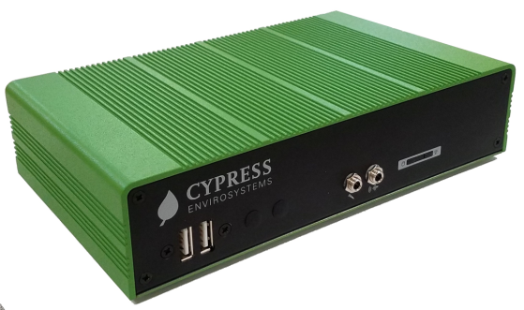
GREEN BOX
CONTROLLER
(INDUSTRIAL)
(GBC-820-IND-LoRa)
FEATURES:
Integrates with HUB to log, display, control, and trend data from Wireless Gauge Readers, Wireless Transducer Readers and Wireless Steam Trap Monitors.
Windows 10 Pro Operating System
Built-in web pages for direct access to data and trending
Each GBC supports 100 devices in typical installation*
Used with LoRa wireless devices from Cypress Envirosystems
Available OPC and RESTful API connectivity for integration with existing automation systems
Alarm notifications via emails
Stores up to one month of historical data
Easy to mount on wall
Fanless low-power design
Supports dual 10 / 100/ 1000 Mbps Ethernet ports
ROHS Compliant
Network and Data Controller for Cypress Envirosystems wireless sensor networks. Use to make data available to existing automation systems, or use standalone with the Web interface.
The Green Box Controller (GBC) is a flexible communications gateway that logs data from the Cypress Envirosystems wireless sensor network and provides it to users and automation systems through a variety of interfaces.
For users with existing automation systems and operator workstations, it provides data over OPC, BACnet/IP or RESTful API for seamless integration and transparent co-existence with plant management systems.
For users which do not need to connect to existing infrastructure, the Green Box Controller can also provide data directly to users via a standalone web interface accessible via a web browser from any computer. Alarm notification may be sent to any email address, which may be routed to any cell phone via text message.
*The design maximum is 225 devices per GBC, but most site layouts impose a practical limit of about 100 devices per GBC.
PBGBC-201706

Slide 2
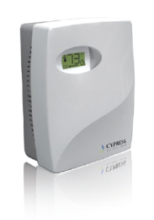
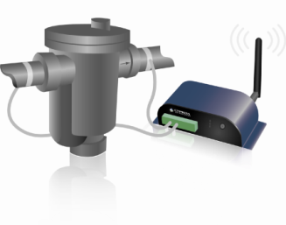
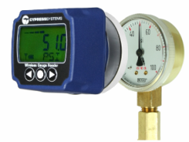
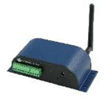
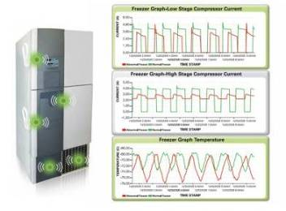
KEY PRODUCT SPECIFICATIONS:
User Interface:
Available Data Protocols:
Mobile Access:
Approvals:
Power Supply:
Humidity:
Operating Temperature:
Storage Temperature:
Vibration Endurance:
Dimensions:
Weight:
Built-in web pages for easy web browser access to control, data and trending
OPC DA, RESTful API
Alarm notification via email or text message
ROHS compliant; certified by US Federal GSA for use on US Gov’t networks
Input: 90-264VAC, 36W; Output: DC 12V @ 3A
10% - 90%, non-condensing
-4°F to 131°F (-20°C to 55°C)
-4°F to 131°F (-20°C to 55°C)
3 Grms (5 – 500Hz, X Y, Z directions)
Length – 7.87 in (200mm) Width – 4.72 in (120mm) Depth – 1.81 in (46mm)
3.97lb (1.8kg)
OUR FAMILY OF PRODUCTS:
WIRELESS PNEUMATIC
THERMOSTAT (WPT)
WIRELESS STEAM TRAP
MONITOR (WSTM)
WIRELESS GAUGE
READER (WGR)
WIRELESS TRANSDUCER
READER (WTR)
WIRELESS FREEZER
MONITOR (WFM)
HEADQUARTERS
5883 Rue Ferrari, Suite 100
San Jose, CA 95138
+1 800 544-5411
www.CypressEnvirosystems.com
info@CypressEnvirosystems.com
Cypress Envirosystems and its logo are trademarks of Cypress Envirosystems, Inc. The name of any other company, products, or services mentioned herein are for identification purposes only and may be trademarks or service marks of or may be copyrighted by their respective holders.
Copyright 2017 Cypress Envirosystems, Inc. All rights reserved.
PBGBC-201706

