Slide 1
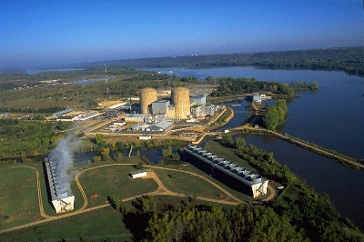

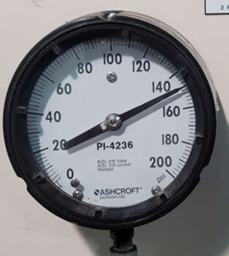
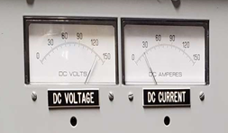
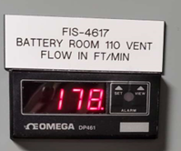

Prairie Island
Site Survey
June 6-7, 2022

Slide 2
Prairie Island Site Survey - Summary
399 Points we can read – approximately 50% of Operator Rounds
  168 Gauges with Needles (use Wireless Gauge Reader to read)
    128 standard gauges, standard installation
    11 need to tape tail of needle
    18 need to remove sticker from under glass
    1 with loose glass
    9 are high up – need Ops concurrence to install
  22 Numeric Displays (use Wireless Digit Reader to read)
    19 standard displays, standard installation
    3 have displays off or not always on
  153 Indicator Lights (use Indicator Light WTR to read)
  6 Thermometers (use WHTM as ambient thermometer)
  50 Calculated Values (values calculated from instrument readings)

Slide 3
Prairie Island Site Survey - Summary
Points we cannot read:
  Visual check of room/surrounding area
  Requires operator to push button/actuate/test
  Tubes
  Sight glasses
  Controller panels (e.g. air compressor control panel)

Slide 4
Budgetary Quote
NRE to install GBC application on Xcel Windows Server per Nick’s request.
One Year Parts and Labor Warranty Included
Suggest to budget $70,000 per year annual maintenance starting year 2

Slide 5
Background Details

Slide 6
Prairie Island Site Survey - Summary
399 Points we can read – about 50% of Operator Rounds
  168 Gauges with Needles (use Wireless Gauge Reader to read)
    128 standard gauges, standard installation
    11 need to tape tail of needle
    18 need to remove sticker from under glass
    1 with loose glass
    9 are high up – need Ops concurrence to install
  22 Numeric Displays (use Wireless Digit Reader to read)
    19 standard displays, standard installation
    3 have displays off or not always on
  153 Indicator Lights (use Indicator Light WTR to read)
  6 Thermometers (use WHTM as ambient thermometer)
  50 Calculated Values (values calculated from instrument readings)

Slide 7
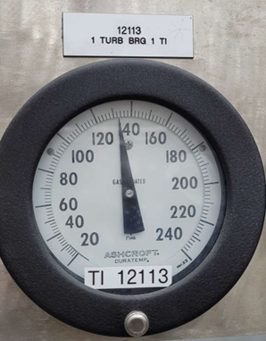
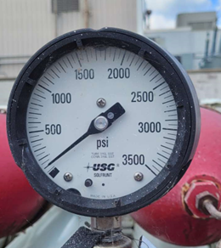
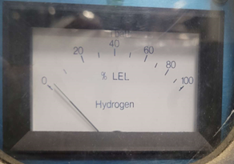
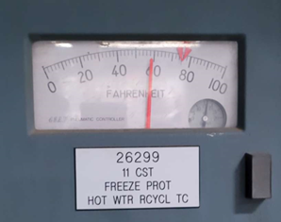
Gauges with Needles - examples

Slide 8
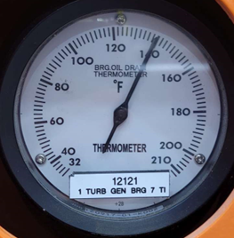
Gauges with Needles – Need to tape tail
Needle same width head and tail
Open glass, taped tail

Slide 9
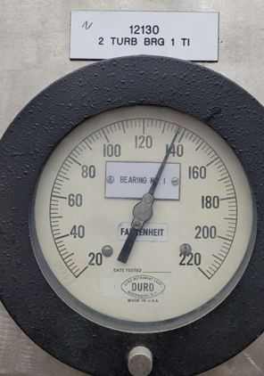
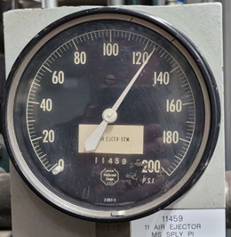
Gauges with Needles – Remove sticker
Open glass lens, remove sticker, replace glass lens

Slide 10
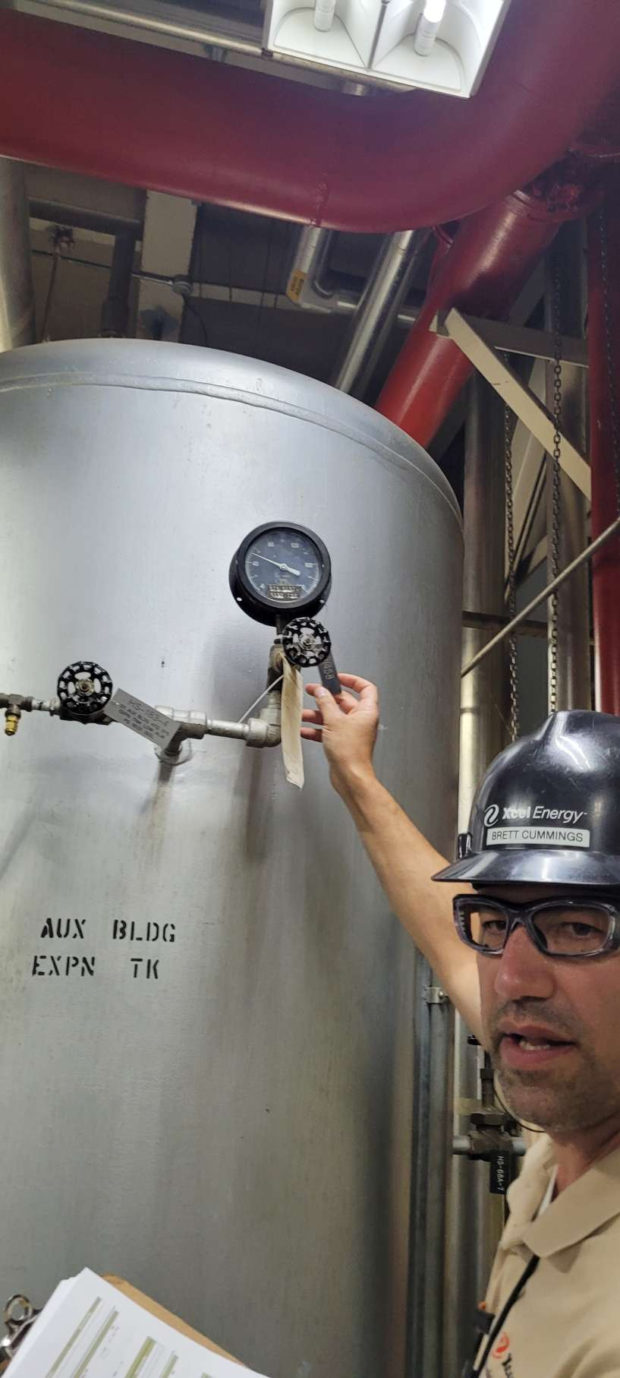
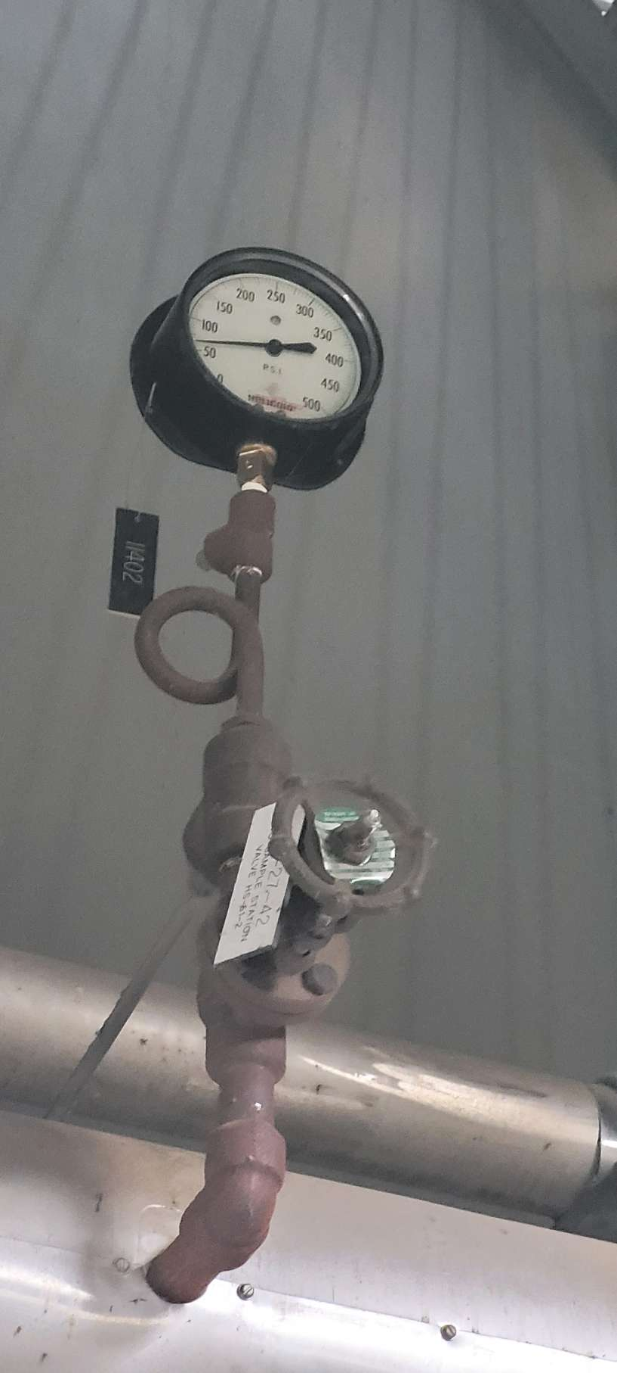
Gauges with Needles – High Location
Check with Ops to see if OK to cover gauge with WGR

Slide 11
Prairie Island Site Survey - Summary
399 Points we can read – about 50% of Operator Rounds
  168 Gauges with Needles (use Wireless Gauge Reader to read)
    128 standard gauges, standard installation
    11 need to tape tail of needle
    18 need to remove sticker from under glass
    1 with loose glass
    9 are high up – need Ops concurrence to install
  22 Numeric Displays (use Wireless Digit Reader to read)
    19 standard displays, standard installation
    3 have displays off or not always on
  153 Indicator Lights (use Indicator Light WTR to read)
  6 Thermometers (use WHTM as ambient thermometer)
  50 Calculated Values (values calculated from instrument readings)

Slide 12
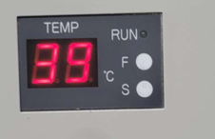
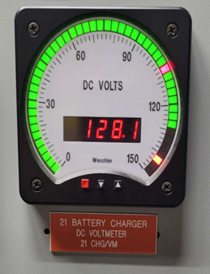
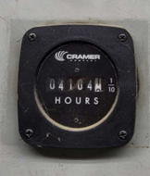
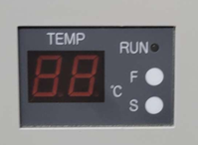
Numeric Displays - examples
Display off unless chiller unit turned-on

Slide 13
Prairie Island Site Survey - Summary
399 Points we can read – about 50% of Operator Rounds
  168 Gauges with Needles (use Wireless Gauge Reader to read)
    128 standard gauges, standard installation
    11 need to tape tail of needle
    18 need to remove sticker from under glass
    1 with loose glass
    9 are high up – need Ops concurrence to install
  22 Numeric Displays (use Wireless Digit Reader to read)
    19 standard displays, standard installation
    3 have displays off or not always on
  153 Indicator Lights (use Indicator Light WTR to read)
  6 Thermometers (use WHTM as ambient thermometer)
  50 Calculated Values (values calculated from instrument readings)

Slide 14
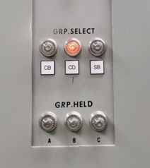
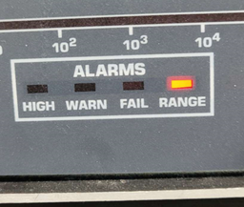
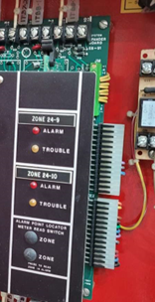
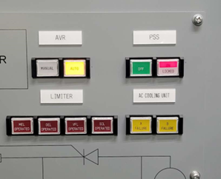
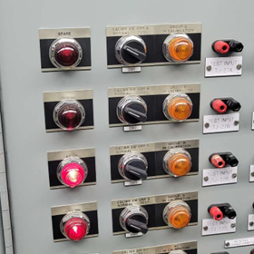
Indicator Lights - examples

Slide 15
Prairie Island Site Survey - Summary
399 Points we can read – about 50% of Operator Rounds
  168 Gauges with Needles (use Wireless Gauge Reader to read)
    128 standard gauges, standard installation
    11 need to tape tail of needle
    18 need to remove sticker from under glass
    1 with loose glass
    9 are high up – need Ops concurrence to install
  22 Numeric Displays (use Wireless Digit Reader to read)
    19 standard displays, standard installation
    3 have displays off or not always on
  153 Indicator Lights (use Indicator Light WTR to read)
  6 Thermometers (use WHTM as ambient thermometer)
  50 Calculated Values (values calculated from instrument readings)

Slide 16
Prairie Island Site Survey - Summary
399 Points we can read – about 50% of Operator Rounds
  168 Gauges with Needles (use Wireless Gauge Reader to read)
    128 standard gauges, standard installation
    11 need to tape tail of needle
    18 need to remove sticker from under glass
    1 with loose glass
    9 are high up – need Ops concurrence to install
  22 Numeric Displays (use Wireless Digit Reader to read)
    19 standard displays, standard installation
    3 have displays off or not always on
  153 Indicator Lights (use Indicator Light WTR to read)
  6 Thermometers (use WHTM as ambient thermometer)
  50 Calculated Values (values calculated from instrument readings)

Slide 17
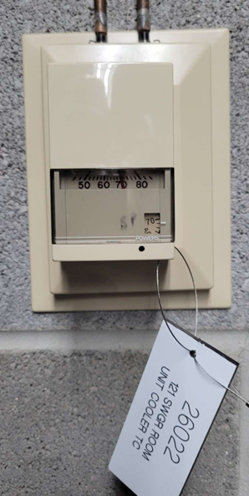
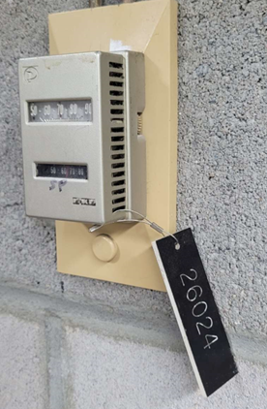
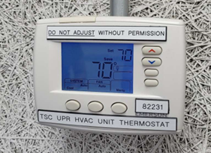
Thermometers - examples

Slide 18
Detail by Operator Round Sequence
and Instrument

Slide 19
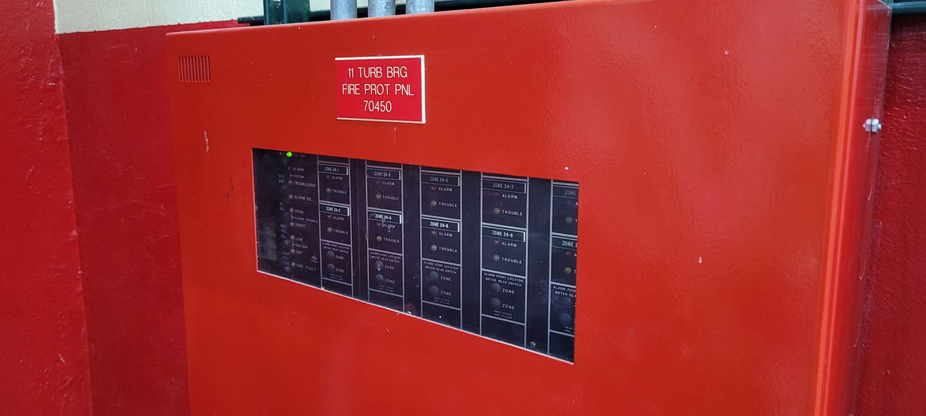
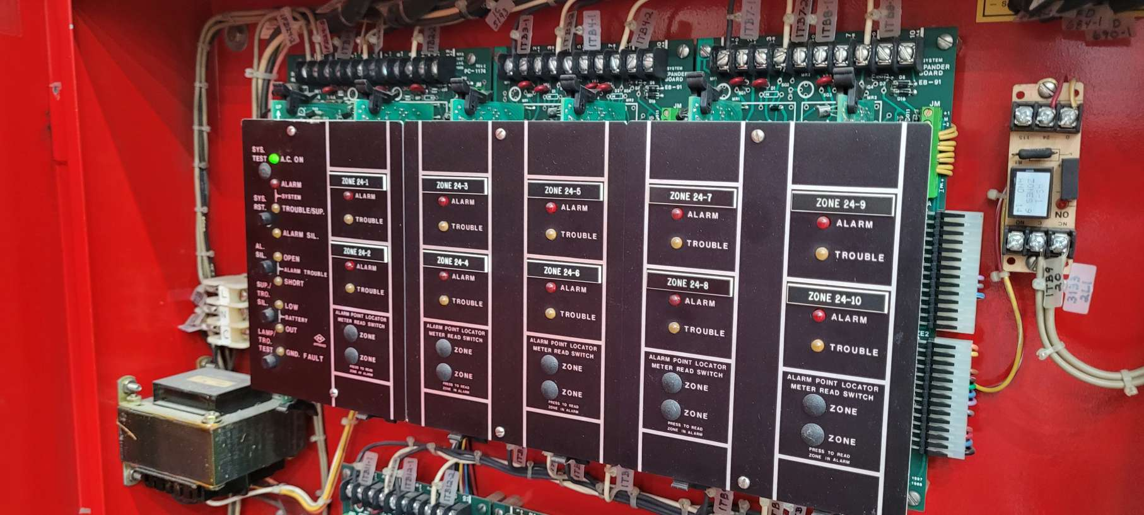
SITE WALK REPORT
Site: PI - Unit 1 Turb Bldg
Seq: 2
Tag: 70450
Type: Light
Count: 20
Possible: Yes
Comments:
Filename: 20220606_115123+seq2!70450.jpg
20220606_115128+seq2!70450.jpg

Slide 20
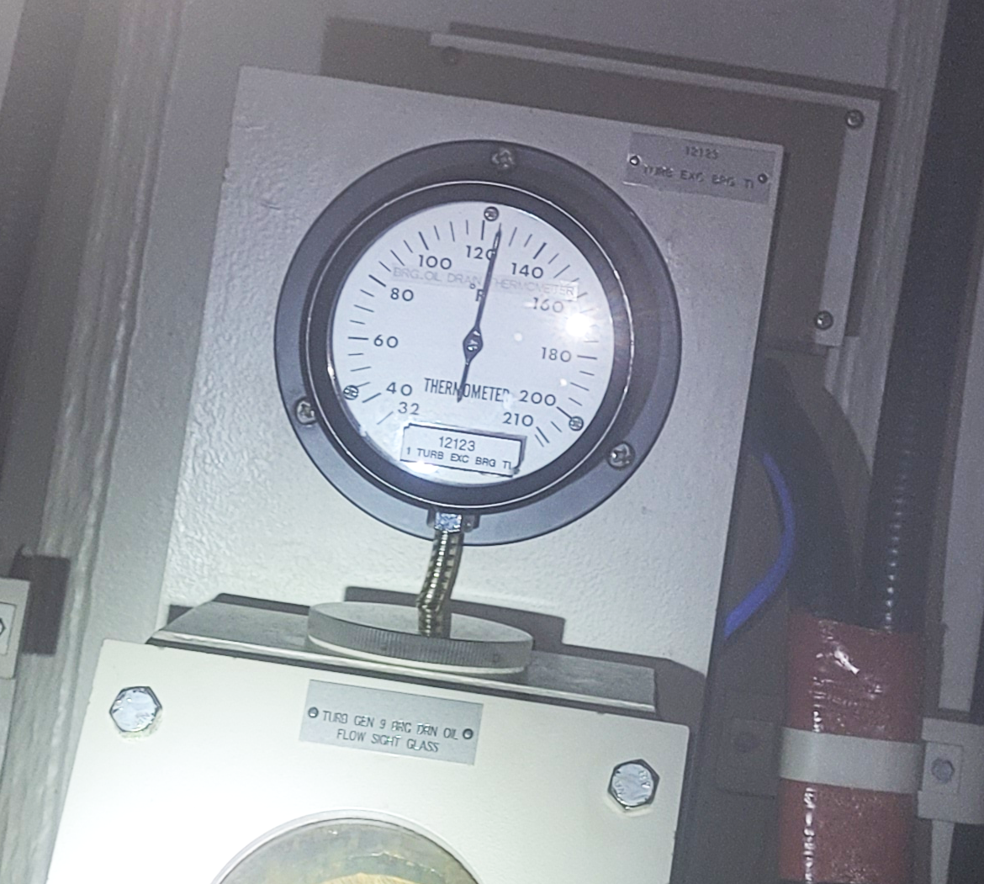
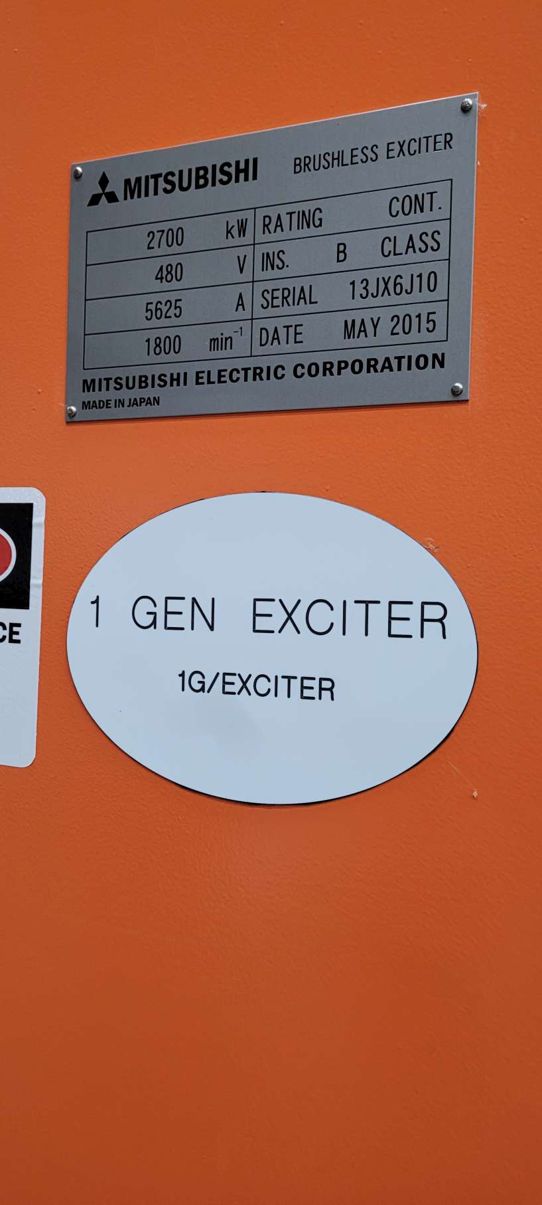
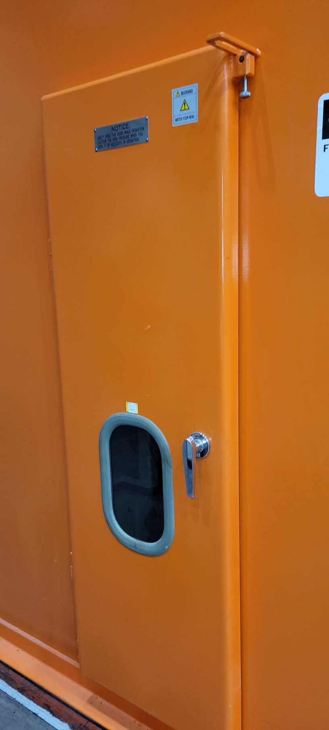
SITE WALK REPORT
Site: PI - Unit 1 Turb Bldg
Seq: 6
Tag: 12123
Type: Gauge
Count: 1
Possible: Yes*
Comments: Tape Tail
Filename: 20220606_115504+seq6!12123.jpg
20220606_115521+seq7!11209.jpg
20220606_115531+seq7!11209.jpg

Slide 21
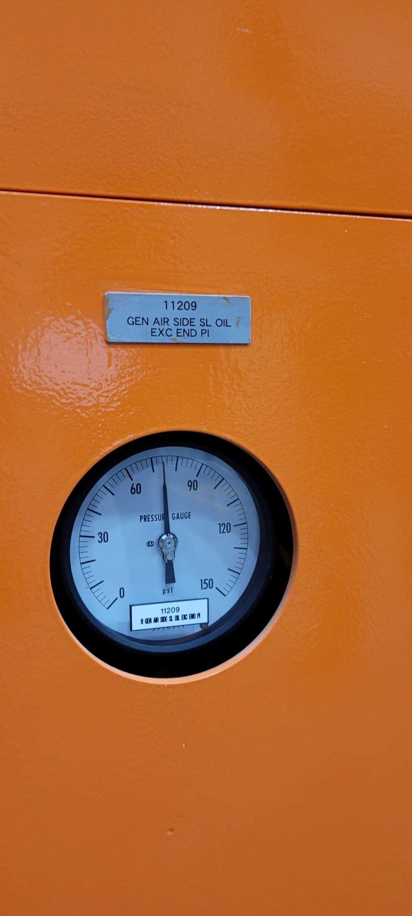
SITE WALK REPORT
Site: PI - Unit 1 Turb Bldg
Seq: 7
Tag: 11209
Type: Gauge
Count: 1
Possible: Yes
Comments:
Filename: 20220606_115622+seq7!11209.jpg

Slide 22
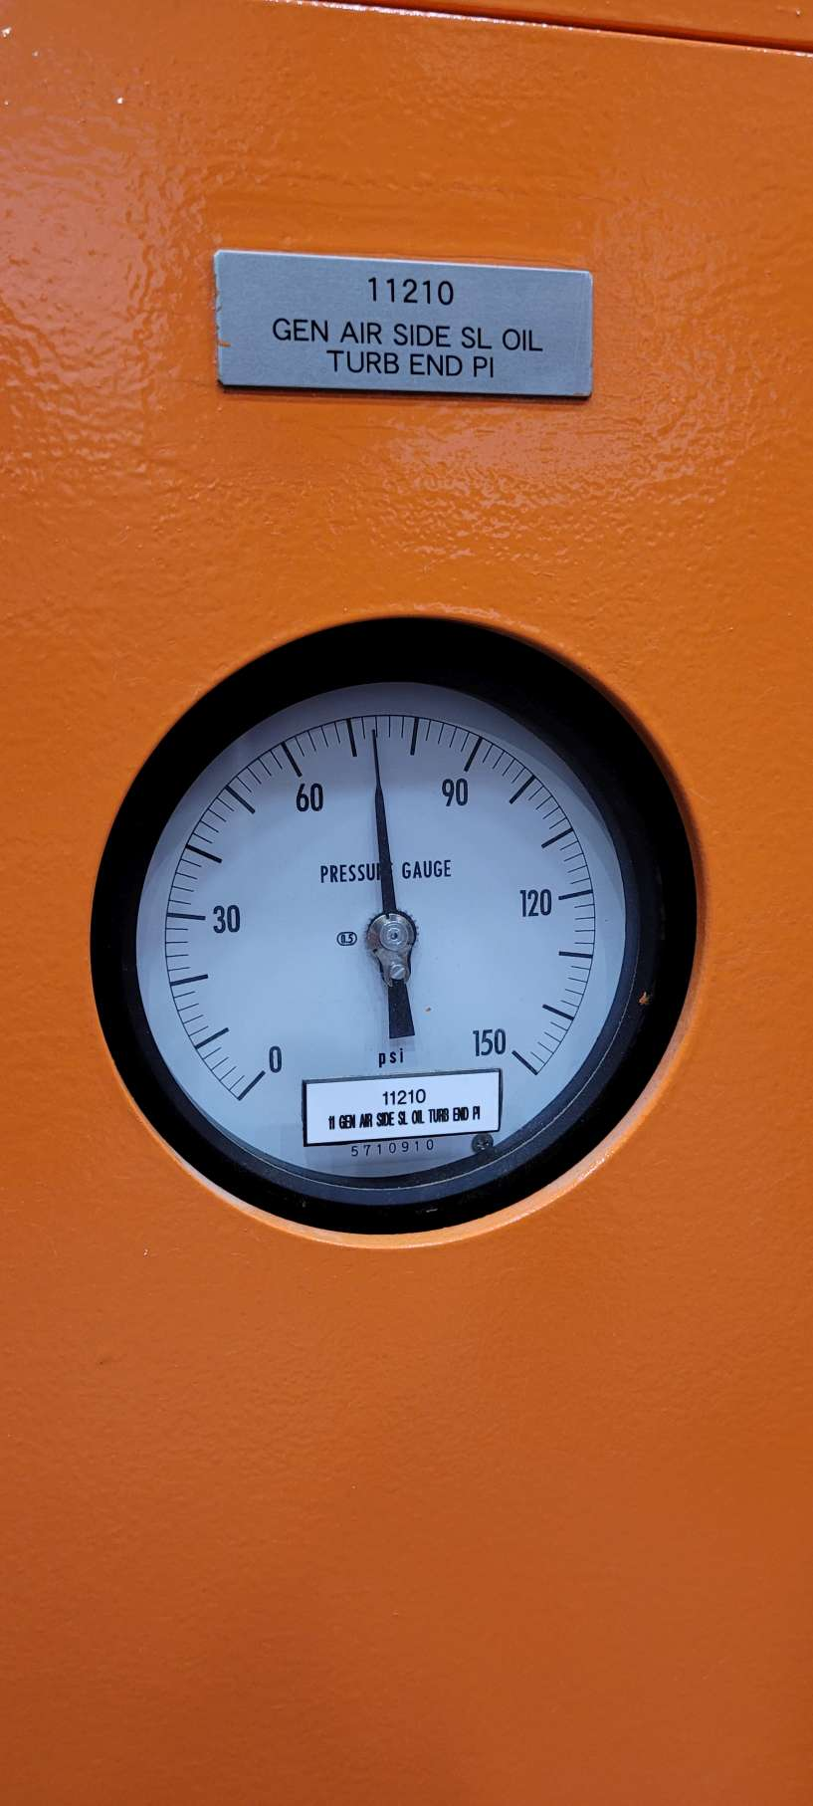
SITE WALK REPORT
Site: PI - Unit 1 Turb Bldg
Seq: 8
Tag: 11210
Type: Gauge
Count: 1
Possible: Yes
Comments:
Filename: 20220606_115714+seq8!11210.jpg

Slide 23
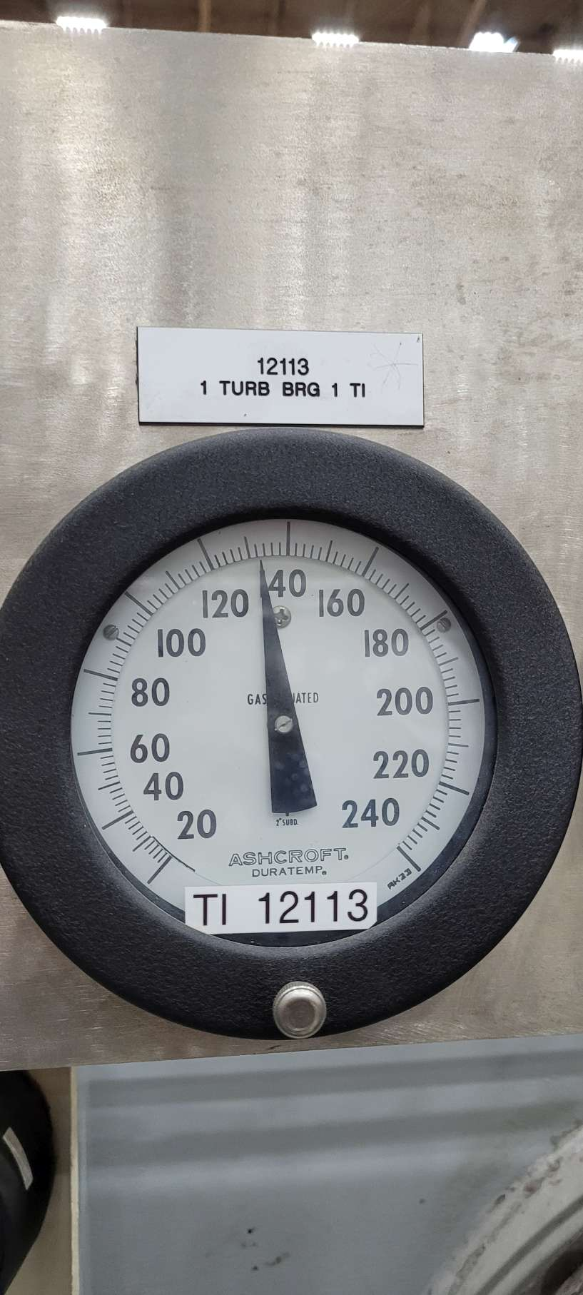
SITE WALK REPORT
Site: PI - Unit 1 Turb Bldg
Seq: 10
Tag: 11213
Type: Gauge
Count: 1
Possible: Yes
Comments:
Filename: 20220606_115837+seq10!11213.jpg

Slide 24
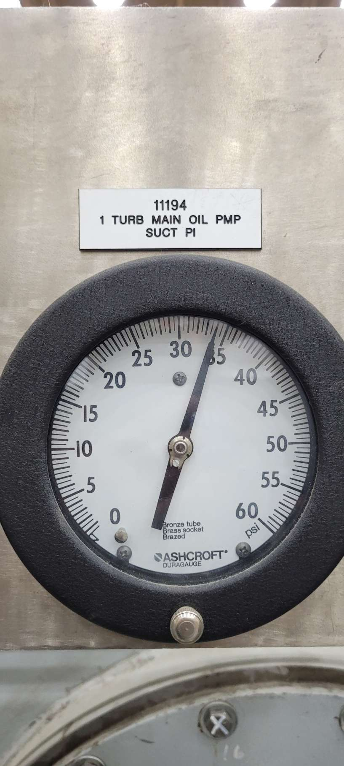
SITE WALK REPORT
Site: PI - Unit 1 Turb Bldg
Seq: 11
Tag: 11194
Type: Gauge
Count: 1
Possible: Yes
Comments:
Filename: 20220606_115901+seq11!11194.jpg

Slide 25
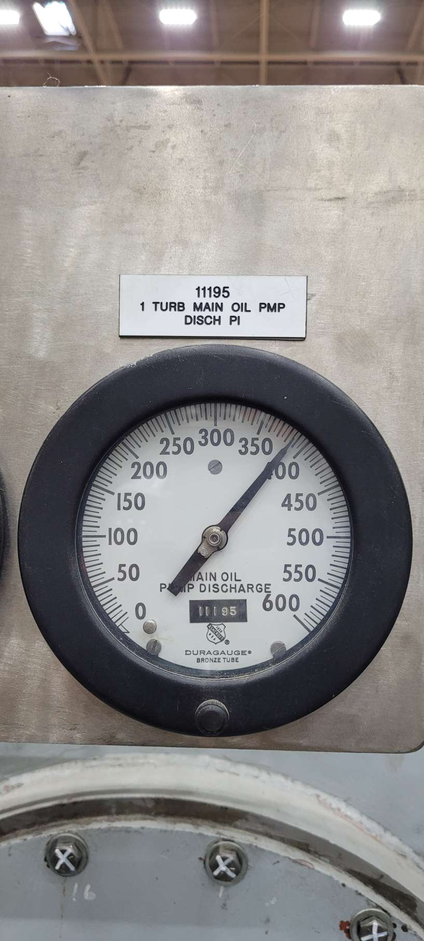
SITE WALK REPORT
Site: PI - Unit 1 Turb Bldg
Seq: 12
Tag: 11195
Type: Gauge
Count: 1
Possible: Yes
Comments:
Filename: 20220606_115911+seq12!11195.jpg

Slide 26
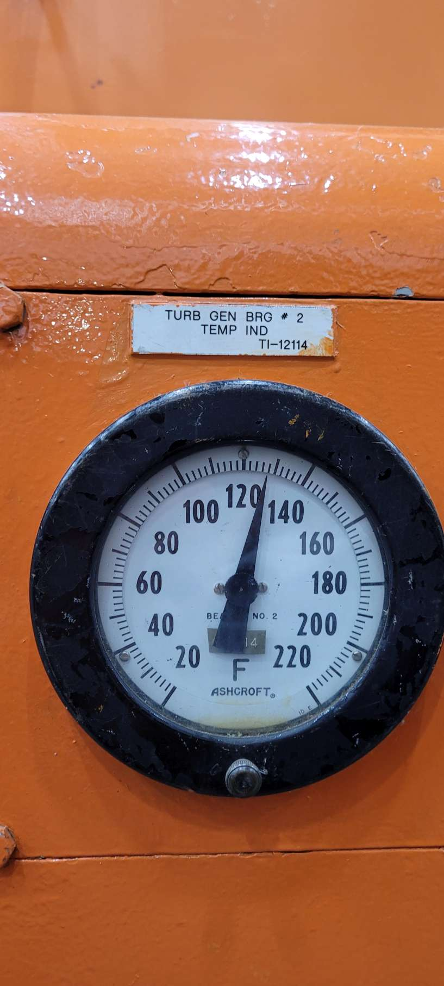
SITE WALK REPORT
Site: PI - Unit 1 Turb Bldg
Seq: 14
Tag: 12114
Type: Gauge
Count: 1
Possible: Yes
Comments:
Filename: 20220606_120036+seq14!12114.jpg

Slide 27
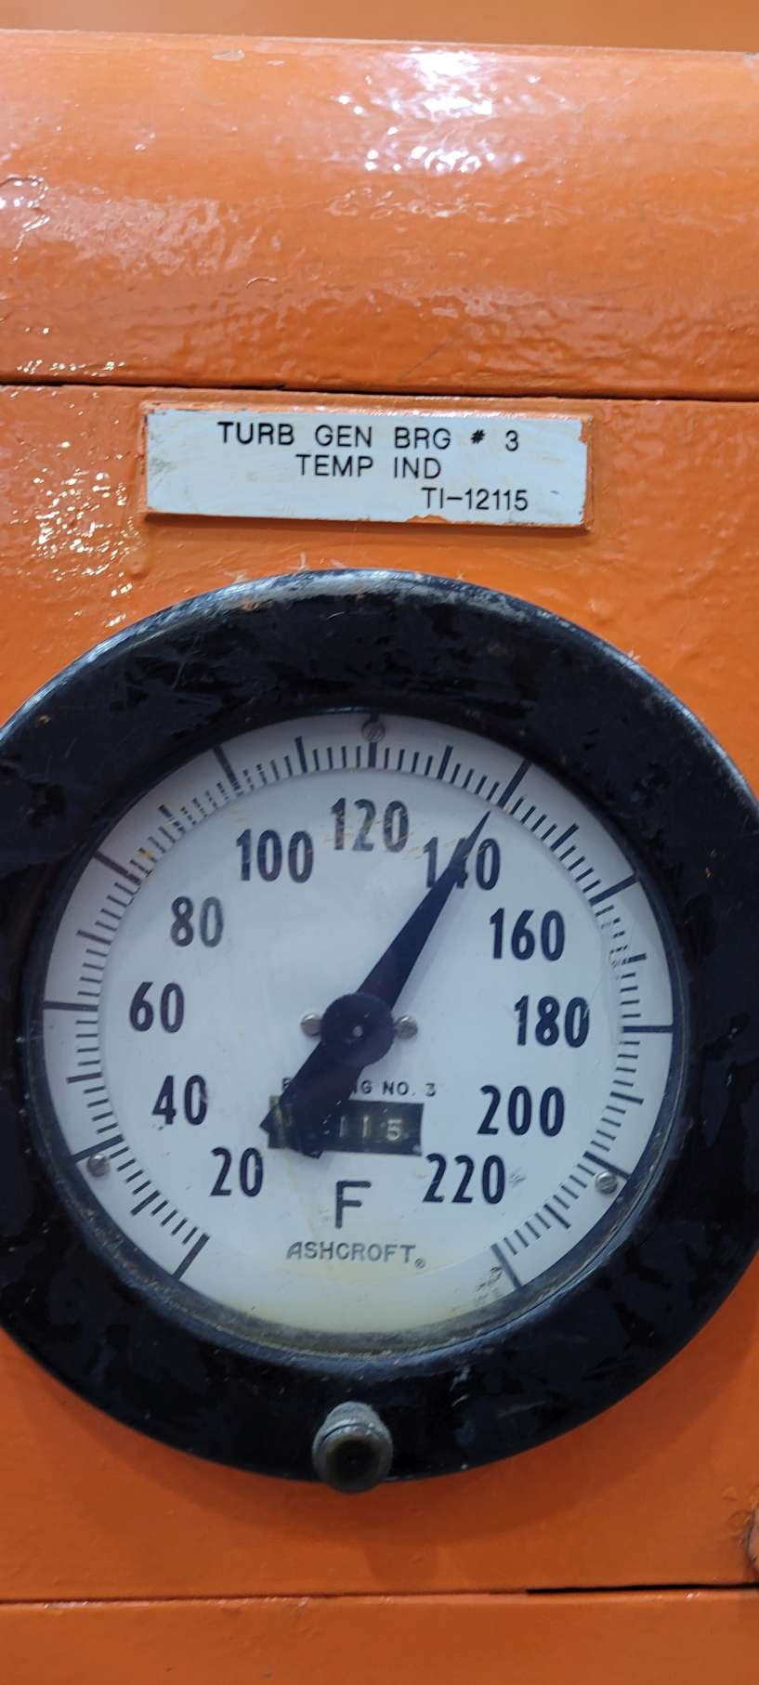
SITE WALK REPORT
Site: PI - Unit 1 Turb Bldg
Seq: 15
Tag: 12115
Type: Gauge
Count: 1
Possible: Yes
Comments:
Filename: 20220606_120038+seq15!12115.jpg

Slide 28
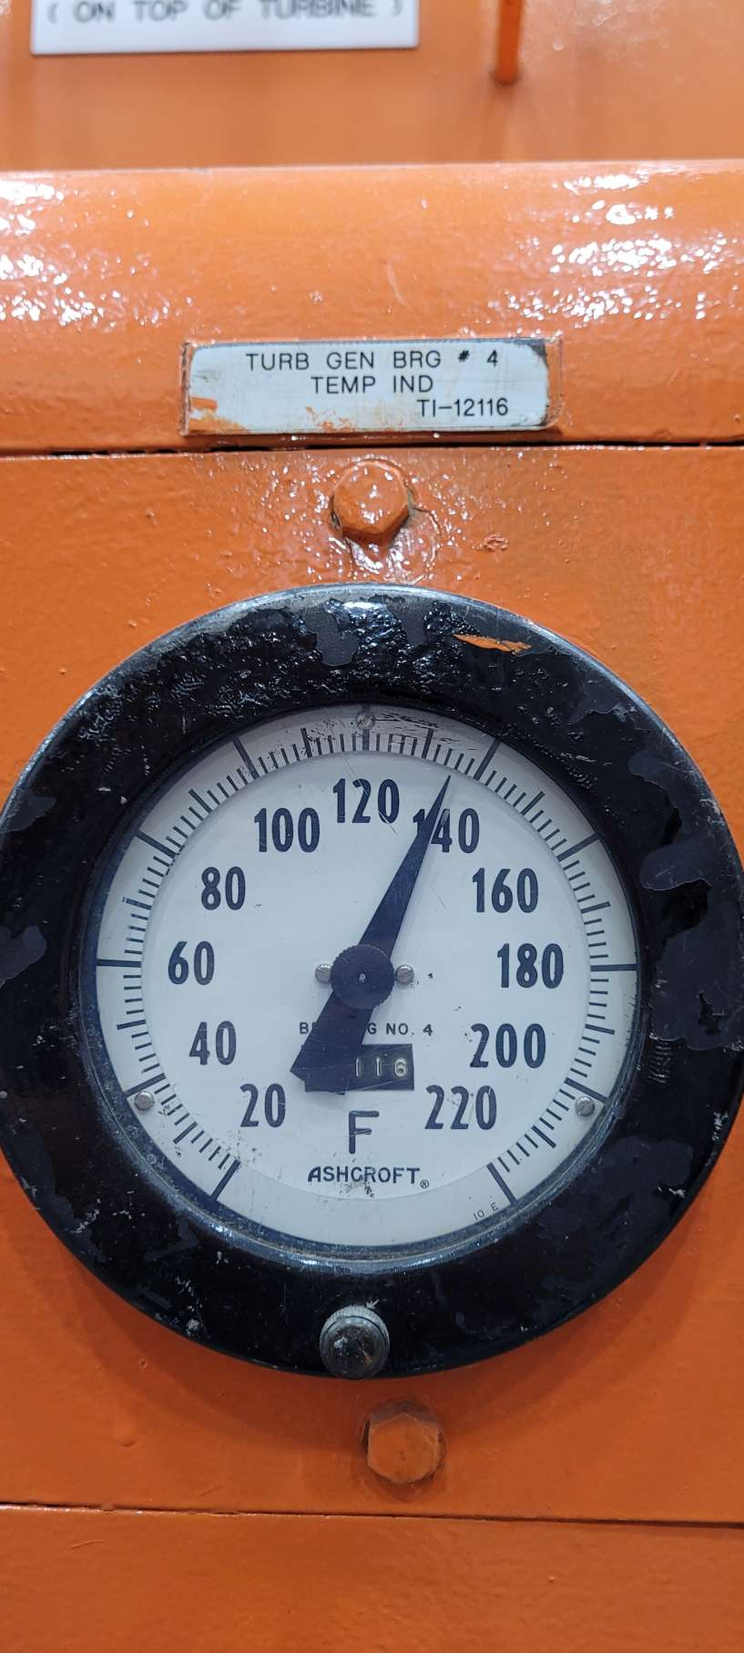
SITE WALK REPORT
Site: PI - Unit 1 Turb Bldg
Seq: 16
Tag: 12116
Type: Gauge
Count: 1
Possible: Yes
Comments:
Filename: 20220606_120104+seq16!12116.jpg

Slide 29
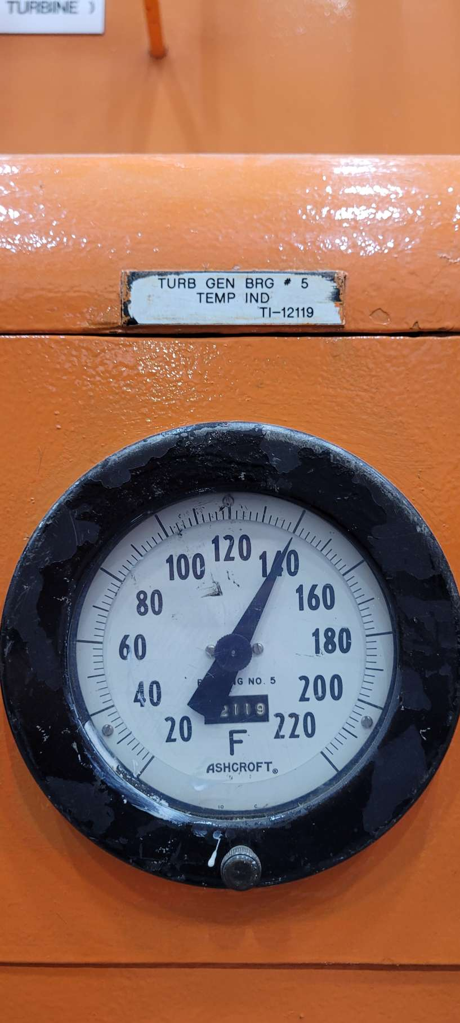
SITE WALK REPORT
Site: PI - Unit 1 Turb Bldg
Seq: 17
Tag: 12119
Type: Gauge
Count: 1
Possible: Yes
Comments:
Filename: 20220606_120107+seq17!12119.jpg

Slide 30
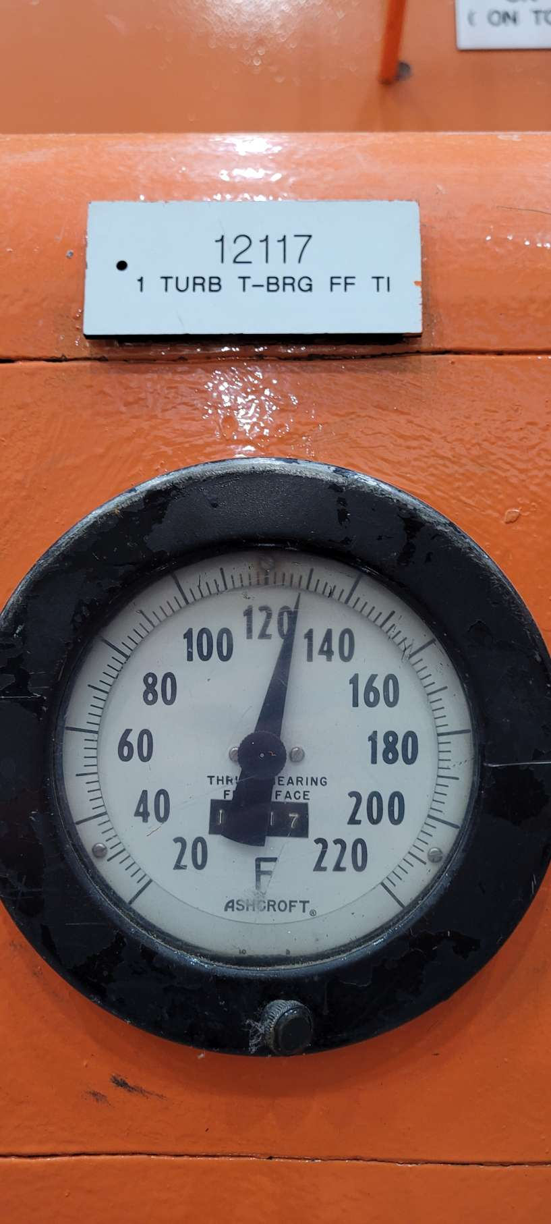
SITE WALK REPORT
Site: PI - Unit 1 Turb Bldg
Seq: 18
Tag: 12117
Type: Gauge
Count: 1
Possible: Yes
Comments:
Filename: 20220606_120119+seq18!12117.jpg

Slide 31
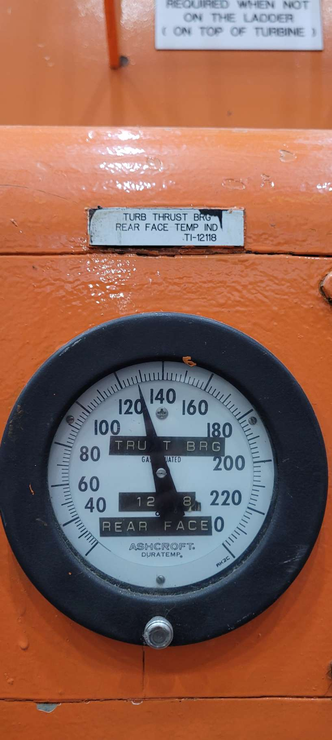
SITE WALK REPORT
Site: PI - Unit 1 Turb Bldg
Seq: 19
Tag: 12118
Type: Gauge
Count: 1
Possible: Yes
Comments:
Filename: 20220606_120122+seq19!12118.jpg

Slide 32
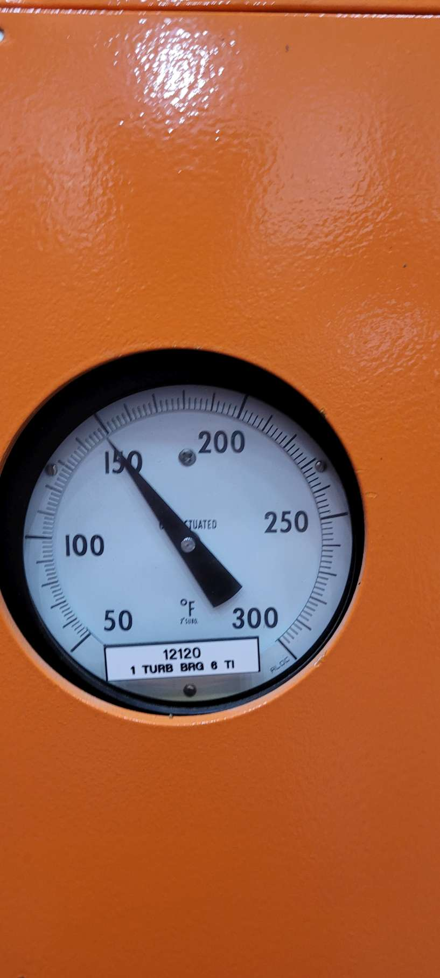
SITE WALK REPORT
Site: PI - Unit 1 Turb Bldg
Seq: 20
Tag: 12120
Type: Gauge
Count: 1
Possible: Yes
Comments:
Filename: 20220606_120221+seq20!12120.jpg

Slide 33
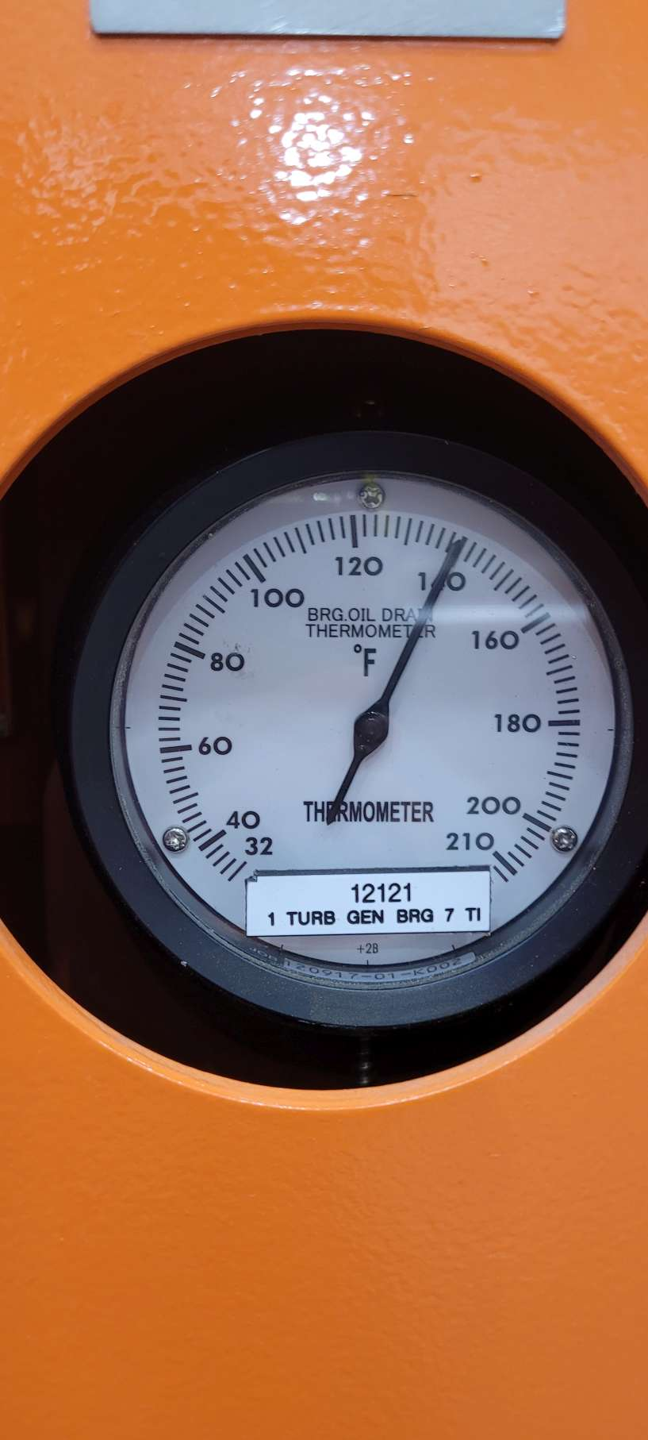
SITE WALK REPORT
Site: PI - Unit 1 Turb Bldg
Seq: 21
Tag: 12121
Type: Gauge
Count: 1
Possible: Yes*
Comments: Tape Tail
Filename: 20220606_120233+seq21!12121.jpg

Slide 34
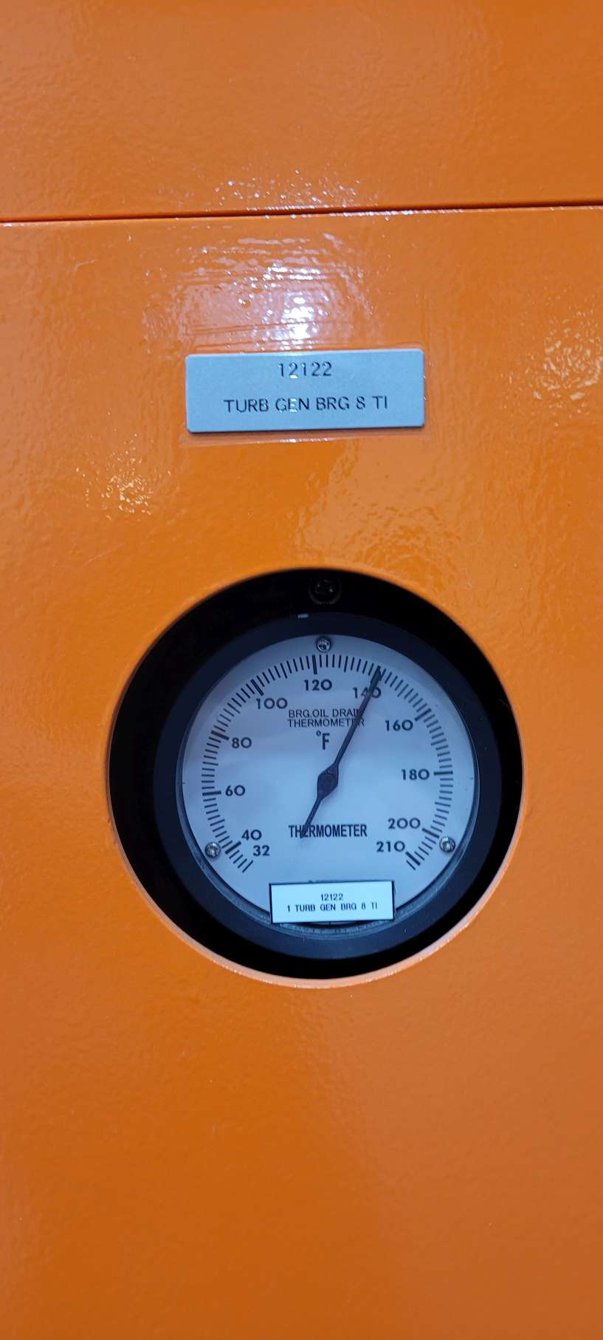
SITE WALK REPORT
Site: PI - Unit 1 Turb Bldg
Seq: 22
Tag: 12122
Type: Gauge
Count: 1
Possible: Yes*
Comments: Tape Tail
Filename: 20220606_120416+seq22!12122.jpg

Slide 35
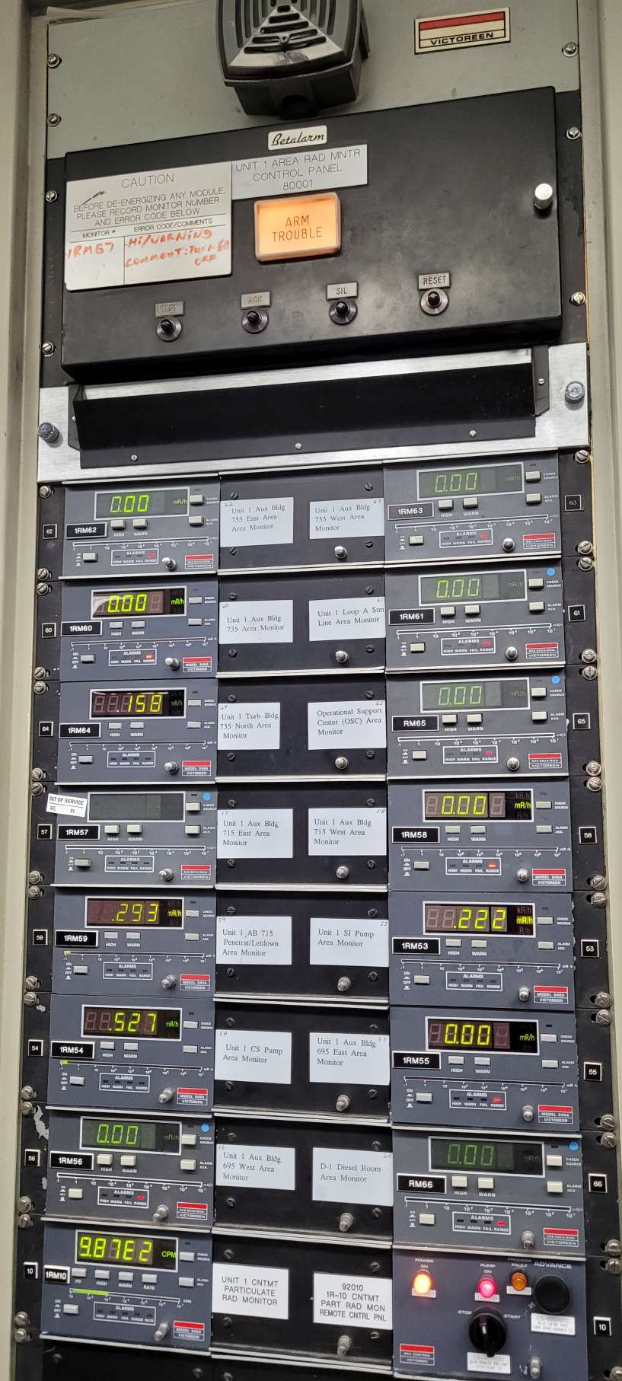
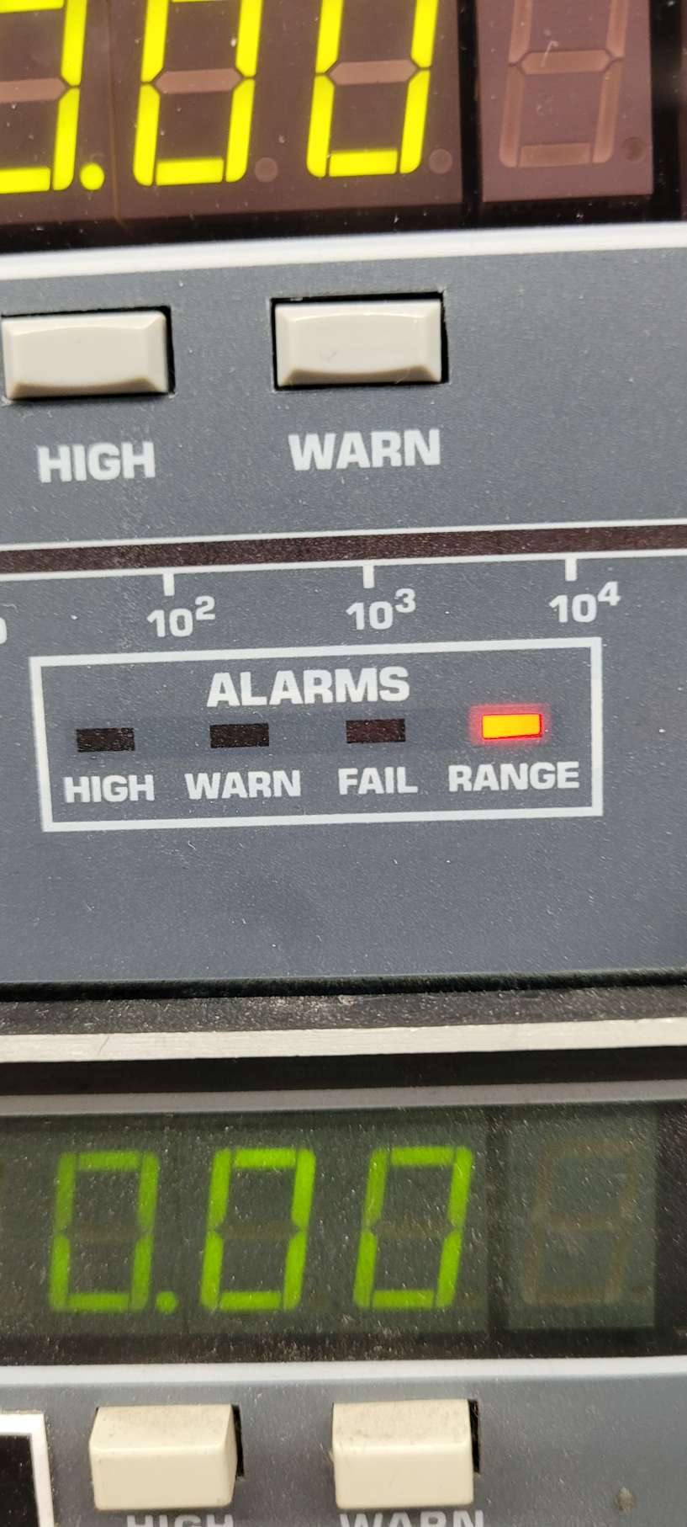
SITE WALK REPORT
Site: PI - Unit 1 Turb Bldg
Seq: 25
Tag: Victoreen
Type: Light
Count: 16
Possible: Yes*
Comments:
Verify Mount
Filename: 20220606_120652+seq25!Victoreen.jpg

Slide 36
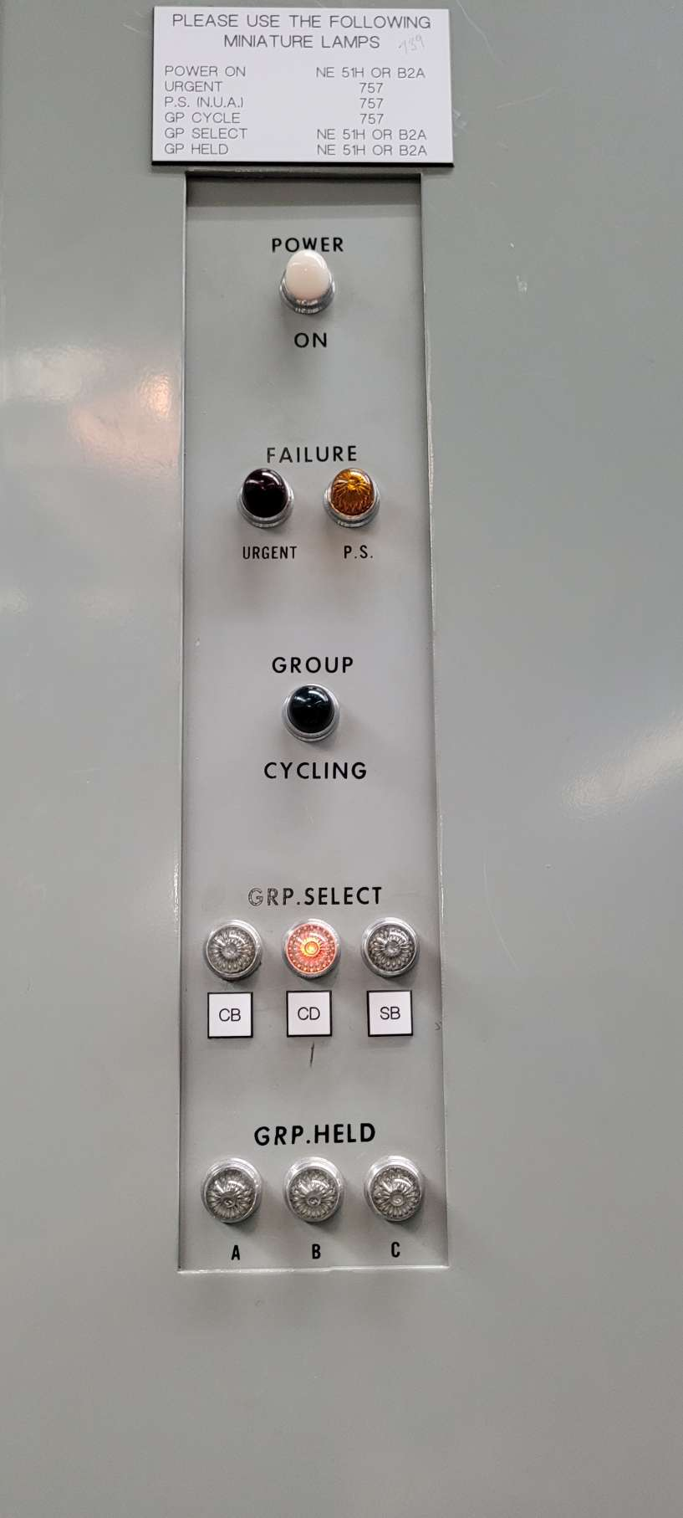
SITE WALK REPORT
Site: PI - Unit 1 Turb Bldg
Seq: 26
Tag: GRP.SEL
Type: Light
Count: 1
Possible: Yes
Comments:
Filename: 20220606_120812+seq26!GRP.SEL.jpg

Slide 37
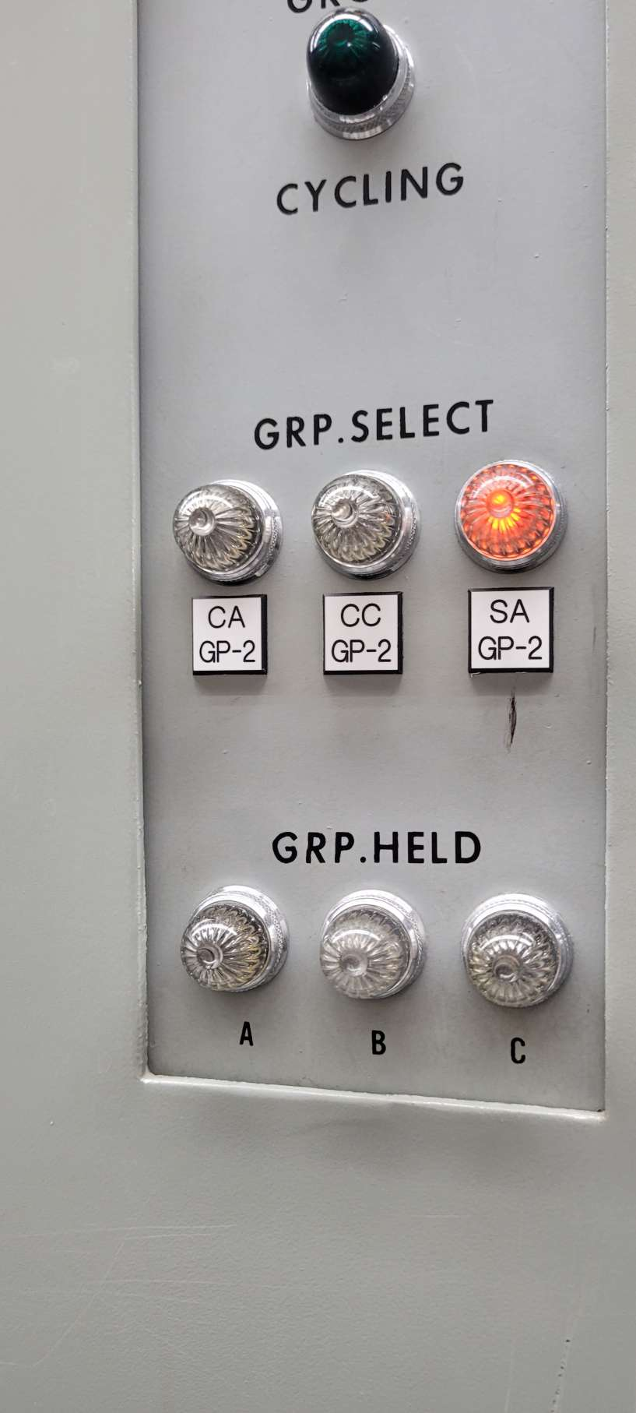
SITE WALK REPORT
Site: PI - Unit 1 Turb Bldg
Seq: 27
Tag: GP-2
Type: Light
Count: 1
Possible: Yes
Comments:
Filename: 20220606_120824+seq27!GP-2.jpg

Slide 38
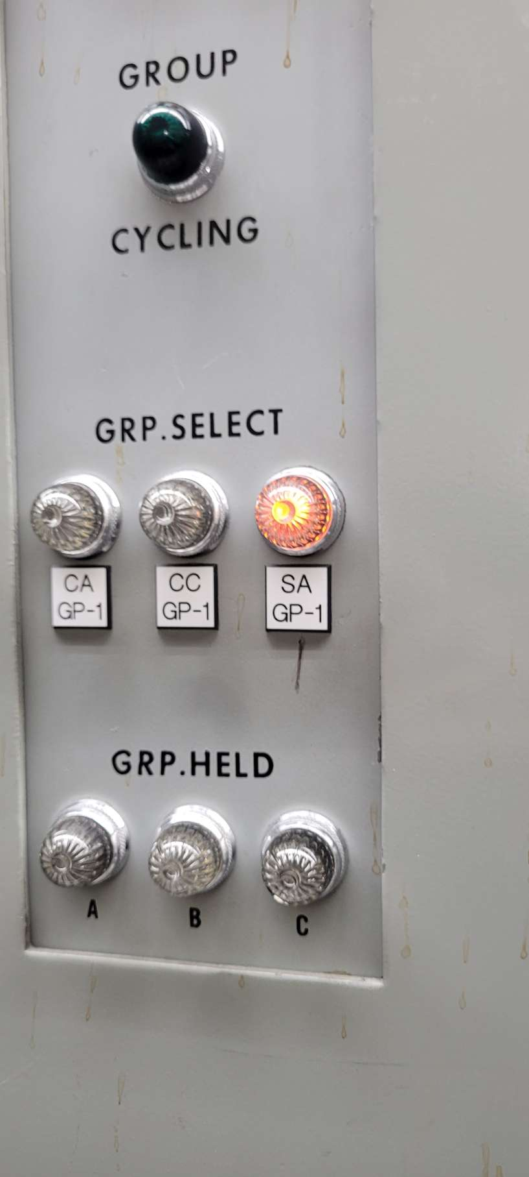
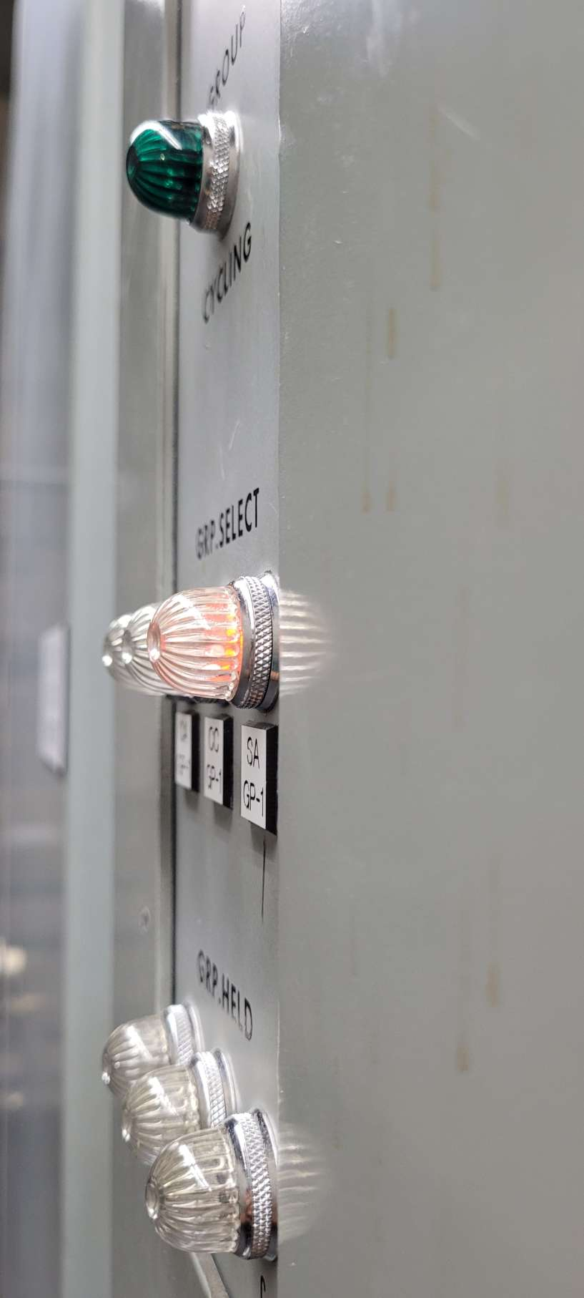
SITE WALK REPORT
Site: PI - Unit 1 Turb Bldg
Seq: 28
Tag: GP-1
Type: Light
Count: 1
Possible: Yes
Comments:
Filename:
20220606_120830+seq28!GP-1.jpg
20220606_120853+seq29!GP-1.jpg

Slide 39

SITE WALK REPORT
Site: PI - Unit 1 Turb Bldg
Seq: 30
Tag: Victoreen
Type: Light
Count: 4
Possible: Yes
Comments:
Filename: 20220606_121604+seq30!Light.jpg

Slide 40

SITE WALK REPORT
Site: PI - Unit 1 Turb Bldg
Seq: 32
Tag: 18435
Type: Gauge
Count: 1
Possible: Yes
Comments:
Filename: 20220606_121823+seq32!18435.jpg

Slide 41

SITE WALK REPORT
Site: PI - Unit 1 Turb Bldg
Seq: 36
Tag: 2603
Type: Thermometer
Count: 1
Possible: Yes*
Comments: WHTM
Filename: 20220606_122050+seq36!Thermometer.jpg

Slide 42

SITE WALK REPORT
Site: PI - Unit 1 Turb Bldg
Seq: 37
Tag: PLC-ON
Type: Light
Count: 2
Possible: No
Comments:
Blinking Light
Filename: 20220606_122141+seq37.jpg

Slide 43

SITE WALK REPORT
Site: PI - Unit 1 Turb Bldg
Seq: 41
Tag: 26022
Type: Thermometer
Count: 1
Possible: Yes*
Comments:
WHTM
Filename: 20220606_122329+seq41!26022.jpg

Slide 44

SITE WALK REPORT
Site: PI - Unit 1 Turb Bldg
Seq: 44
Tag: PLC-ON
Type: Light
Count: 1
Possible: No
Comments:
Blinking Light
Filename: 20220606_122539+seq44!PLC-ON.jpg

Slide 45

SITE WALK REPORT
Site: PI - Unit 1 Turb Bldg
Seq: 47
Tag: 26024
Type: Thermometer
Count: 1
Possible: Yes*
Comments: WHTM
Filename: 20220606_122601+seq41!26024.jpg

Slide 46

SITE WALK REPORT
Site: PI - Unit 1 Turb Bldg
Seq: 49
Tag: 26021
Type: Gauge
Count: 1
Possible: Yes*
Comments: WHTM
Filename: 20220606_122705+seq41!26021.jpg

Slide 47




SITE WALK REPORT
Site: PI - Unit 1 Turb Bldg
Seq: 52
Tag: 81A/B11
Type: Light
Count: 1
Possible: Yes
Comments:
Filename: 20220606_122846.jpg
20220606_122913.jpg
20220606_122916.jpg
20220606_122930.jpg

Slide 48

SITE WALK REPORT
Site: PI - Unit 1 Turb Bldg
Seq: 53
Tag: 81B/B11
Type: Light
Count: 1
Possible: Yes
Comments:
Filename: 20220606_122844.jpg

Slide 49

SITE WALK REPORT
Site: PI - Unit 1 Turb Bldg
Seq: 54
Tag: 81A/B12
Type: Light
Count: 1
Possible: Yes
Comments:
Filename: 20220606_122851.jpg

Slide 50

SITE WALK REPORT
Site: PI - Unit 1 Turb Bldg
Seq: 55
Tag: 81B/B12
Type: Light
Count: 1
Possible: Yes
Comments:
Filename: 20220606_122849.jpg

Slide 51

SITE WALK REPORT
Site: PI - Unit 1 Turb Bldg
Seq: 56
Tag: 17734
Type: Gauge
Count: 1
Possible: Yes
Comments:
Filename: 20220606_123033seq56!17734.jpg

Slide 52

SITE WALK REPORT
Site: PI - Unit 1 Turb Bldg
Seq: 57
Tag: 17733
Type: Gauge
Count: 1
Possible: Yes
Comments:
Filename: 20220606_123044+seq57!17733.jpg

Slide 53

SITE WALK REPORT
Site: PI - Unit 1 Turb Bldg
Seq: 59
Tag: 1481
Type: Tube
Count: 1
Possible: No
Comments:
Filename: 20220606_123129+seq59!1481.jpg

Slide 54

SITE WALK REPORT
Site: PI - Unit 1 Turb Bldg
Seq: 59
Tag: 1481
Type: Tube
Count: 1
Possible: No
Comments:
Filename: 20220606_123131+seq59!1481.jpg

Slide 55

SITE WALK REPORT
Site: PI - Unit 1 Turb Bldg
Seq: 60
Tag: 39040
Type: Light
Count: 1
Possible: Yes
Comments:
Filename: 20220606_123229+seq60!39040.jpg

Slide 56

SITE WALK REPORT
Site: PI - Unit 1 Turb Bldg
Seq: 61
Tag: 11085
Type: Gauge
Count: 1
Possible: Yes
Comments:
Filename: 20220606_123325seq61!11085.jpg

Slide 57


SITE WALK REPORT
Site: PI - Unit 1 Turb Bldg
Seq: 62
Tag: 11459
Type: Gauge
Count: 1
Possible: Yes*
Comments: Remove sticker behind glass
Filename: 20220606_123348seq62!11459.jpg

Slide 58

SITE WALK REPORT
Site: PI - Unit 1 Turb Bldg
Seq: 63
Tag: 11588
Type: Gauge
Count: 1
Possible: Yes
Comments:
Filename: 20220606_123522+seq63!11588.jpg

Slide 59


SITE WALK REPORT
Site: PI - Unit 1 Turb Bldg
Seq: 64
Tag: 16411
Type: Gauge
Count: 1
Possible: Yes
Comments:
Filename: 20220606_123601+seq64!16411.jpg

Slide 60


SITE WALK REPORT
Site: PI - Unit 1 Turb Bldg
Seq: 78
Tag: 28994
Type: Light
Count: 1
Possible: Yes
Comments:
Filename: 20220606_124040seq78!AutoLight.jpg

Slide 61

SITE WALK REPORT
Site: PI - Unit 1 Turb Bldg
Seq: 79
Tag: LockedLight
Type: Light
Count: 1
Possible: Yes
Comments:
Filename: 20220606_124052+seq79!LockedLight.jpg

Slide 62

SITE WALK REPORT
Site: PI - Unit 1 Turb Bldg
Seq: 80
Tag: Mel Operated
Type: Light
Count: 1
Possible: Yes
Comments:
Filename: 20220606_124057+seq80toseq84!NotLit.jpg

Slide 63
SITE WALK REPORT
Site: PI - Unit 1 Turb Bldg
Seq: 81
Tag: OEL Operated
Type: Light
Count: 1
Possible: Yes
Comments:
Filename: 20220606_124057+seq80toseq84!NotLit.jpg

Slide 64
SITE WALK REPORT
Site: PI - Unit 1 Turb Bldg
Seq: 82
Tag: VFL Operated
Type: Light
Count: 1
Possible: Yes
Comments:
Filename: 20220606_124057+seq80toseq84!NotLit.jpg

Slide 65
SITE WALK REPORT
Site: PI - Unit 1 Turb Bldg
Seq: 83
Tag: SCL Operated
Type: Light
Count: 1
Possible: Yes
Comments:
Filename: 20220606_124057+seq80toseq84!NotLit.jpg

Slide 66
SITE WALK REPORT
Site: PI - Unit 1 Turb Bldg
Seq: 84
Tag: A/C Unit Failure
Type: Light
Count: 2
Possible: Yes
Comments:
Filename: 20220606_124057+seq80toseq84!NotLit.jpg

Slide 67

SITE WALK REPORT
Site: PI - Unit 1 Turb Bldg
Seq: 85
Tag: A/C Unit A
Type: Digit
Count: 1
Possible: Yes*
Comments: Unit may be off?
Filename: 20220606_124213+seq85!Tempdigit.jpg

Slide 68

SITE WALK REPORT
Site: PI - Unit 1 Turb Bldg
Seq: 85
Tag: A/C Unit B
Type: Digit
Count: 1
Possible: Yes*
Comments: Unit may be off?
Filename: 20220606_124218+seq85!digit not lit.jpg

Slide 69

SITE WALK REPORT
Site: PI - Unit 1 Turb Bldg
Seq: 86
Tag:
Type: Tube
Count: 1
Possible: No
Comments:
Filename: 20220606_124325+seq86.jpg

Slide 70

SITE WALK REPORT
Site: PI - Unit 1 Turb Bldg
Seq: 87
Tag:
Type: Tube
Count: 1
Possible: No
Comments:
Filename: 20220606_124327+seq87.jpg

Slide 71

SITE WALK REPORT
Site: PI - Unit 1 Turb Bldg
Seq: 88
Tag: 11139
Type: Gauge
Count: 1
Possible: Yes*
Comments: Remove sticker behind glass
Filename: 20220606_124617+seq88!11139.jpg

Slide 72

SITE WALK REPORT
Site: PI - Unit 1 Turb Bldg
Seq: 89
Tag: 18335
Type: Tube
Count: 1
Possible: No
Comments:
Filename: 20220606_124712+seq89!18335.jpg

Slide 73

SITE WALK REPORT
Site: PI - Unit 1 Turb Bldg
Seq: 89
Tag: 11835
Type: Gauge
Count: 1
Possible: Yes
Comments:
Filename: 20220606_124716+seq89!11835.jpg

Slide 74
SITE WALK REPORT
Site: PI - Unit 1 Turb Bldg
Seq: 90
Tag: 11458
Type: Gauge
Count: 1
Possible: Yes*
Comments: High
Filename: 20220606_124814+seq90!11458.jpg

Slide 75


SITE WALK REPORT
Site: PI - Unit 1 Turb Bldg
Seq: 91
Tag: 11457
Type: Gauge
Count: 1
Possible: Yes*
Comments: High
Filename: 20220606_124820+seq91!11457.jpg

Slide 76

SITE WALK REPORT
Site: PI - Unit 1 Turb Bldg
Seq: Unknown
Tag: 16120
Type: Gauge
Count: 1
Possible: Yes
Comments:
Filename: 20220606_125017.jpg

Slide 77

SITE WALK REPORT
Site: PI - Unit 1 Turb Bldg
Seq: 96
Tag: 11138
Type: Gauge
Count: 1
Possible: Yes
Comments:
Filename: 20220606_125223+seq96!11138.jpg

Slide 78

SITE WALK REPORT
Site: PI - Unit 1 Turb Bldg
Seq: 97
Tag: 11476
Type: Gauge
Count: 1
Possible: Yes
Comments:
Filename: 20220606_125317+seq97!11476.jpg

Slide 79

SITE WALK REPORT
Site: PI - Unit 1 Turb Bldg
Seq: 99
Tag: 18008
Type: Gauge
Count: 1
Possible: Yes
Comments:
Filename: 20220606_125409.jpg

Slide 80

SITE WALK REPORT
Site: PI - Unit 1 Turb Bldg
Seq: 100
Tag: 18009
Type: Gauge
Count: 1
Possible: Yes
Comments:
Filename: 20220606_125411.jpg

Slide 81

SITE WALK REPORT
Site: PI - Unit 1 Turb Bldg
Seq: 100
Tag: 52001
Type: Gauge
Count: 1
Possible: Yes
Comments:
Filename: 20220606_125455+seq100!52001.jpg

Slide 82


SITE WALK REPORT
Site: PI - Unit 1 Turb Bldg
Seq: 101
Tag: 11322
Type: Gauge
Count: 1
Possible: Yes
Comments:
Filename: 20220606_125941+seq101!11322.jpg

Slide 83


SITE WALK REPORT
Site: PI - Unit 1 Turb Bldg
Seq: 102
Tag: 11321
Type: Gauge
Count: 1
Possible: Yes
Comments:
Filename: 20220606_125930+seq102!11321.jpg

Slide 84

SITE WALK REPORT
Site: PI - Unit 1 Turb Bldg
Seq: 103
Tag: 11320
Type: Gauge
Count: 1
Possible: Yes
Comments:
Filename: 20220606_125922+seq103!11320.jpg

Slide 85

SITE WALK REPORT
Site: PI - Unit 1 Turb Bldg
Seq: 105
Tag: 17857
Type: Gauge
Count: 1
Possible: Yes*
Comments: Mask lettering behind glass
Filename: 20220606_130513+seq105!17857.jpg

Slide 86

SITE WALK REPORT
Site: PI - Unit 1 Turb Bldg
Seq: 106
Tag: 18070
Type: Gauge
Count: 1
Possible: Yes
Comments:
Filename: 20220606_130522+seq106!18070.jpg

Slide 87

SITE WALK REPORT
Site: PI - Unit 1 Turb Bldg
Seq: 107
Tag: 11293
Type: Gauge
Count: 1
Possible: Yes
Comments:
Filename: 20220606_130826+seq107!11293.jpg

Slide 88

SITE WALK REPORT
Site: PI - Unit 1 Turb Bldg
Seq: 108
Tag: 11294
Type: Gauge
Count: 1
Possible: Yes
Comments:
Filename: 20220606_130828+seq108!11294.jpg

Slide 89

SITE WALK REPORT
Site: PI - Unit 1 Turb Bldg
Seq: 109
Tag: 11470
Type: Gauge
Count: 1
Possible: Yes
Comments:
Filename: 20220606_131028+seq109!11470.jpg

Slide 90

SITE WALK REPORT
Site: PI - Unit 1 Turb Bldg
Seq: 110
Tag: 12203
Type: Gauge
Count: 1
Possible: Yes
Comments:
Need to clean glass
Filename: 20220606_131216+seq110!12203.jpg

Slide 91

SITE WALK REPORT
Site: PI - Unit 1 Turb Bldg
Seq: 111
Tag: 12204
Type: Gauge
Count: 1
Possible: Yes
Comments:
Filename: 20220606_131240+seq111!12204.jpg

Slide 92

SITE WALK REPORT
Site: PI - Unit 1 Turb Bldg
Seq: 112
Tag: 11375
Type: Gauge
Count: 1
Possible: Yes
Comments:
Filename: 20220606_131303+seq112!11375.jpg

Slide 93

SITE WALK REPORT
Site: PI - Unit 1 Turb Bldg
Seq: 113
Tag: 11376
Type: Gauge
Count: 1
Possible: Yes
Comments:
Filename: 20220606_131306+seq113!11376.jpg

Slide 94

SITE WALK REPORT
Site: PI - Unit 1 Turb Bldg
Seq: 114
Tag: 11377
Type: Gauge
Count: 1
Possible: Yes*
Comments: Remove sticker behind glass
Filename: 20220606_131309+seq114!11377.jpg

Slide 95

SITE WALK REPORT
Site: PI - Unit 1 Turb Bldg
Seq: 116
Tag: 11215
Type: Gauge
Count: 1
Possible: Yes
Comments:
High
Filename: 20220606_131636+seq116!11215.jpg

Slide 96

SITE WALK REPORT
Site: PI - Unit 1 Turb Bldg
Seq: 117
Tag: 71080
Type: Light
Count: 1
Possible: No
Comments:
Filename: 20220606_131735+seq117!71080.jpg

Slide 97



SITE WALK REPORT
Site: PI - Unit 1 Turb Bldg
Seq: 117
Tag: 71080
Type: Light
Count: 2
Possible: Yes
Comments:
Filename: 20220606_131741+seq117!71080-Power and Safe Lights.jpg

Slide 98


SITE WALK REPORT
Site: PI - Unit 1 Turb Bldg
Seq: 121
Tag: 70405
Type: Digit
Count: 1
Possible: Yes
Comments:
Filename: 20220606_132005+seq121!70405.jpg
20220606_132018.jpg

Slide 99



SITE WALK REPORT
Site: PI - Unit 1 Turb Bldg
Seq: 122
Tag: Gas Purity
Type: Digit
Count: 1
Possible: Yes
Comments:
Filename: 20220606_132028+seq122!Gas Purity.jpg
20220606_132112.jpg

Slide 100
SITE WALK REPORT
Site: PI - Unit 1 Turb Bldg
Seq: 122
Tag: Gas Purity
Type: Digit
Count: 1
Possible: Yes
Comments:
Filename: 20220606_132032+seq122!Gas Purity.jpg

Slide 101

SITE WALK REPORT
Site: PI - Unit 1 Turb Bldg
Seq: 123
Tag: 70405
Type: Gauge
Count: 1
Possible: Yes
Comments:
Filename: 20220606_132124+seq123!Inches.jpg

Slide 102


SITE WALK REPORT
Site: PI - Unit 1 Turb Bldg
Seq: 124
Tag: 18438
Type: Gauge
Count: 1
Possible: Yes
Comments:
Filename: 20220606_132214seq124!18438.jpg

Slide 103

SITE WALK REPORT
Site: PI - Unit 1 Turb Bldg
Seq: 125
Tag: 12109
Type: Gauge
Count: 1
Possible: Yes*
Comments: Tape Tail
Filename: 20220606_132335+seq125!12109.jpg

Slide 104

SITE WALK REPORT
Site: PI - Unit 1 Turb Bldg
Seq: 126
Tag: 12110
Type: Gauge
Count: 1
Possible: Yes*
Comments: Tape Tail
Filename: 20220606_132342+seq126!12110.jpg

Slide 105

SITE WALK REPORT
Site: PI - Unit 1 Turb Bldg
Seq: 129
Tag: 11213
Type: Gauge
Count: 1
Possible: Yes
Comments:
Filename: 20220606_132425+seq129!11213.jpg

Slide 106

SITE WALK REPORT
Site: PI - Unit 1 Turb Bldg
Seq: 130
Tag: 11214
Type: Gauge
Count: 1
Possible: Yes
Comments:
Filename: 20220606_132427+seq130!11214.jpg

Slide 107

SITE WALK REPORT
Site: PI - Unit 1 Turb Bldg
Seq: 131
Tag: 11565
Type: Gauge
Count: 1
Possible: Yes
Comments:
Filename: 20220606_132531+seq131!11565.jpg

Slide 108

SITE WALK REPORT
Site: PI - Unit 1 Turb Bldg
Seq: 132
Tag: 11211
Type: Gauge
Count: 1
Possible: Yes
Comments:
Filename: 20220606_132542+seq132!11211.jpg

Slide 109

SITE WALK REPORT
Site: PI - Unit 1 Turb Bldg
Seq: 137
Tag: BKR133-4
Type: Digit
Count: 1
Possible: Yes
Comments:
Filename: 20220606_132727+seq137!BKR133-4.jpg

Slide 110

SITE WALK REPORT
Site: PI - Unit 1 Turb Bldg
Seq: 138
Tag: BKR143-4
Type: Digit
Count: 1
Possible: Yes
Comments:
Filename: 20220606_132731+seq138!BKR143-4.jpg

Slide 111
SITE WALK REPORT
Site: PI - Unit 1 Turb Bldg
Seq: 140
Tag: 11402
Type: Gauge
Count: 1
Possible: Yes*
Comments: High
Filename: 20220606_132833+seq140!11402.jpg

Slide 112

SITE WALK REPORT
Site: PI - Unit 1 Turb Bldg
Seq: 141
Tag: O2Pressure
Type: Gauge
Count: 1
Possible: Yes*
Comments: Replace broken gauge
Filename: 20220606_132931+seq141!O2Pressure.jpg

Slide 113
SITE WALK REPORT
Site: PI - Unit 1 Turb Bldg
Seq: 153
Tag: 12438
Type: Gauge
Count: 1
Possible: Yes*
Comments: Need Pic
Filename: NoPic

Slide 114

SITE WALK REPORT
Site: PI - Unit 1 Turb Bldg
Seq: 143
Tag: 26299
Type: Gauge
Count: 1
Possible: Yes
Comments:
Filename: 20220606_133010+seq143!26299.jpg

Slide 115

SITE WALK REPORT
Site: PI - Unit 2 Turb Bldg
Seq: 3
Tag: 11663
Type: Gauge
Count: 1
Possible: Yes
Comments:
Filename: 20220607_075411+seq!11663.jpg

Slide 116

SITE WALK REPORT
Site: PI - Unit 2 Turb Bldg
Seq: 4
Tag: 11655
Type: Gauge
Count: 1
Possible: Yes
Comments:
Filename: 20220607_075537!11655.jpg

Slide 117

SITE WALK REPORT
Site: PI - Unit 2 Turb Bldg
Seq: 5
Tag: 17410
Type: Gauge
Count: 1
Possible: Yes
Comments:
Filename: 20220607_075600!17410.jpg

Slide 118

SITE WALK REPORT
Site: PI - Unit 2 Turb Bldg
Seq: 6
Tag: 17408
Type: Gauge
Count: 1
Possible: Yes
Comments:
Filename: 20220607_075617!17408.jpg

Slide 119

SITE WALK REPORT
Site: PI - Unit 2 Turb Bldg
Seq: 7
Tag: 17411
Type: Gauge
Count: 1
Possible: Yes
Comments:
Filename: 20220607_075635!17411.jpg

Slide 120

SITE WALK REPORT
Site: PI - Unit 2 Turb Bldg
Seq: 8
Tag: 17409
Type: Gauge
Count: 1
Possible: Yes
Comments:
Filename: 20220607_075642!17409.jpg

Slide 121
SITE WALK REPORT
Site: PI - Unit 2 Turb Bldg
Seq: 9
Tag: Hour Meter
Type: Digit
Count: 1
Possible: Yes*
Comments: Need Picture
Filename:

Slide 122


SITE WALK REPORT
Site: PI - Unit 2 Turb Bldg
Seq: 10
Tag:
Type: Gauge
Count: 1
Possible: Yes
Comments:
Filename: 20220607_075712.jpg

Slide 123

SITE WALK REPORT
Site: PI - Unit 2 Turb Bldg
Seq: 11
Tag:
Type: Gauge
Count: 1
Possible: Yes
Comments:
Filename: 20220607_075717.jpg

Slide 124

SITE WALK REPORT
Site: PI - Unit 2 Turb Bldg
Seq: 12
Tag:
Type: Gauge
Count: 1
Possible: Yes
Comments:
Filename: 20220607_075728.jpg

Slide 125


SITE WALK REPORT
Site: PI - Unit 2 Turb Bldg
Seq: 13
Tag:
Type: Gauge
Count: 1
Possible: Yes
Comments:
Filename: 20220607_075836.jpg

Slide 126

SITE WALK REPORT
Site: PI - Unit 2 Turb Bldg
Seq: 14
Tag:
Type: Gauge
Count: 1
Possible: Yes
Comments:
Filename: 20220607_075930.jpg

Slide 127

SITE WALK REPORT
Site: PI - Unit 2 Turb Bldg
Seq: 16
Tag: 11053
Type: Gauge
Count: 1
Possible: Yes
Comments:
Filename: 20220607_080026.jpg

Slide 128


SITE WALK REPORT
Site: PI - Unit 2 Turb Bldg
Seq: 17
Tag:
Type: Gauge
Count: 1
Possible: Yes*
Comments: Loose Glass
Filename: 20220607_080103.jpg

Slide 129

SITE WALK REPORT
Site: PI - Unit 2 Turb Bldg
Seq: 19
Tag: 82231
Type: Thermostat
Count: 1
Possible: Yes*
Comments: WHTM
Filename: 20220607_080400.jpg

Slide 130

SITE WALK REPORT
Site: PI - Unit 2 Turb Bldg
Seq: 20
Tag: 82221
Type: Thermostat
Count: 1
Possible: Yes*
Comments: WHTM
Filename: 20220607_080454.jpg

Slide 131

SITE WALK REPORT
Site: PI - Unit 2 Turb Bldg
Seq: 22
Tag: 12130
Type: Gauge
Count: 1
Possible: Yes*
Comments: Remove sticker under glass
Filename: 20220607_080607.jpg

Slide 132

SITE WALK REPORT
Site: PI - Unit 2 Turb Bldg
Seq: 23
Tag: 11413
Type: Gauge
Count: 1
Possible: Yes
Comments:
Filename: 20220607_080615.jpg

Slide 133

SITE WALK REPORT
Site: PI - Unit 2 Turb Bldg
Seq: 24
Tag: 11414
Type: Gauge
Count: 1
Possible: Yes
Comments:
Filename: 20220607_080624.jpg

Slide 134
SITE WALK REPORT
Site: PI - Unit 2 Turb Bldg
Seq: 26
Tag: 18374
Type: Gauge
Count: 1
Possible: Yes*
Comments: Need Picture
Filename: 20220607_081016.jpg

Slide 135

SITE WALK REPORT
Site: PI - Unit 2 Turb Bldg
Seq: 27
Tag: 12131
Type: Gauge
Count: 1
Possible: Yes
Comments:
Filename: 20220607_081016.jpg

Slide 136

SITE WALK REPORT
Site: PI - Unit 2 Turb Bldg
Seq: 28
Tag: 12132
Type: Gauge
Count: 1
Possible: Yes*
Comments: Remove sticker under glass
Filename: 20220607_081020.jpg

Slide 137

SITE WALK REPORT
Site: PI - Unit 2 Turb Bldg
Seq: 29
Tag: 12133
Type: Gauge
Count: 1
Possible: Yes*
Comments: Remove sticker under glass
Filename: 20220607_081046.jpg

Slide 138

SITE WALK REPORT
Site: PI - Unit 2 Turb Bldg
Seq: 30
Tag: 12134
Type: Gauge
Count: 1
Possible: Yes*
Comments: Remove sticker under glass
Filename: 20220607_081049.jpg

Slide 139

SITE WALK REPORT
Site: PI - Unit 2 Turb Bldg
Seq: 31
Tag: 12200
Type: Gauge
Count: 1
Possible: Yes*
Comments: Remove sticker under glass
Filename: 20220607_081219.jpg

Slide 140

SITE WALK REPORT
Site: PI - Unit 2 Turb Bldg
Seq: 32
Tag: 12201
Type: Gauge
Count: 1
Possible: Yes*
Comments: Remove sticker under glass
Filename: 20220607_081230.jpg

Slide 141

SITE WALK REPORT
Site: PI - Unit 2 Turb Bldg
Seq: 33
Tag: 12135
Type: Gauge
Count: 1
Possible: Yes
Comments:
Filename: 20220607_081310.jpg

Slide 142

SITE WALK REPORT
Site: PI - Unit 2 Turb Bldg
Seq: 34
Tag: 12137
Type: Gauge
Count: 1
Possible: Yes*
Comments: Tape tail
Filename: 20220607_081315.jpg

Slide 143

SITE WALK REPORT
Site: PI - Unit 2 Turb Bldg
Seq: 36
Tag: 12138
Type: Gauge
Count: 1
Possible: Yes*
Comments: Tape tail
Filename: 20220607_081533.jpg

Slide 144

SITE WALK REPORT
Site: PI - Unit 2 Turb Bldg
Seq: 37
Tag: 12202
Type: Gauge
Count: 1
Possible: Yes*
Comments: Tape Tail
Filename: 20220607_081623.jpg

Slide 145

SITE WALK REPORT
Site: PI - Unit 2 Turb Bldg
Seq: 38
Tag: 11216
Type: Gauge
Count: 1
Possible: Yes
Comments:
Filename: 20220607_081649.jpg

Slide 146

SITE WALK REPORT
Site: PI - Unit 2 Turb Bldg
Seq: 39
Tag: 11217
Type: Gauge
Count: 1
Possible: Yes
Comments:
Filename: 20220607_081724.jpg

Slide 147


SITE WALK REPORT
Site: PI - Unit 2 Turb Bldg
Seq: 42
Tag: Victoreen
Type: Light
Count: 19
Possible: Yes*
Comments: Verify Mounting
Filename: 20220607_082037.jpg

Slide 148

SITE WALK REPORT
Site: PI - Unit 2 Turb Bldg
Seq: 43
Tag: GP-1
Type: Light
Count: 1
Possible: Yes
Comments:
Filename: 20220607_082110.jpg

Slide 149

SITE WALK REPORT
Site: PI - Unit 2 Turb Bldg
Seq: 44
Tag: GP-2
Type: Light
Count: 1
Possible: Yes
Comments:
Filename: 20220607_082140.jpg

Slide 150

SITE WALK REPORT
Site: PI - Unit 2 Turb Bldg
Seq: 45
Tag: CD
Type: Light
Count: 1
Possible: Yes
Comments:
Filename: 20220607_082208.jpg

Slide 151

SITE WALK REPORT
Site: PI - Unit 2 Turb Bldg
Seq: 49
Tag: 74060
Type: Light
Count: 40
Possible: Yes
Comments:
Filename: 20220607_082544.jpg

Slide 152


SITE WALK REPORT
Site: PI - Unit 2 Turb Bldg
Seq: 51
Tag: 13-2
Type: Gauge
Count: 1
Possible: Yes
Comments:
Filename: 20220607_082827.jpg

Slide 153

SITE WALK REPORT
Site: PI - Unit 2 Turb Bldg
Seq: 52
Tag: 12027
Type: Gauge
Count: 1
Possible: Yes*
Comments: High
Filename: 20220607_083017.jpg

Slide 154

SITE WALK REPORT
Site: PI - Unit 2 Turb Bldg
Seq: 53
Tag: 12028
Type: Gauge
Count: 1
Possible: Yes*
Comments: High
Filename: 20220607_083030.jpg

Slide 155

SITE WALK REPORT
Site: PI - Unit 2 Turb Bldg
Seq: 54
Tag: 12041
Type: Gauge
Count: 1
Possible: Yes*
Comments: High
Filename: 20220607_083117.jpg

Slide 156

SITE WALK REPORT
Site: PI - Unit 2 Turb Bldg
Seq: 55
Tag: 12042
Type: Gauge
Count: 1
Possible: Yes
Comments: High
Filename: 20220607_083226.jpg

Slide 157


SITE WALK REPORT
Site: PI - Unit 2 Turb Bldg
Seq: 56
Tag: 24-7
Type: Gauge
Count: 1
Possible: Yes
Comments:
Filename: 20220607_083309.jpg

Slide 158

SITE WALK REPORT
Site: PI - Unit 2 Turb Bldg
Seq: 57
Tag: 81A/B21
Type: Light
Count: 1
Possible: Yes
Comments:
Filename: 20220607_083414.jpg

Slide 159

SITE WALK REPORT
Site: PI - Unit 2 Turb Bldg
Seq: 58
Tag: 81B/B21
Type: Light
Count: 1
Possible: Yes
Comments:
Filename: 20220607_083348.jpg

Slide 160

SITE WALK REPORT
Site: PI - Unit 2 Turb Bldg
Seq: 59
Tag: 81A/B22
Type: Light
Count: 1
Possible: Yes
Comments:
Filename: 20220607_083354.jpg

Slide 161

SITE WALK REPORT
Site: PI - Unit 2 Turb Bldg
Seq: 60
Tag: 81B/B22
Type: Light
Count: 1
Possible: Yes
Comments:
Filename: 20220607_083357.jpg

Slide 162

SITE WALK REPORT
Site: PI - Unit 2 Turb Bldg
Seq: 61
Tag: BKR 211E-6
Type: Digit
Count: 1
Possible: Yes
Comments:
Filename: 20220607_083548.jpg

Slide 163

SITE WALK REPORT
Site: PI - Unit 2 Turb Bldg
Seq: 63
Tag: BKR 121E-19
Type: Digit
Count: 1
Possible: Yes
Comments:
Filename: 20220607_083831.jpg

Slide 164

SITE WALK REPORT
Site: PI - Unit 2 Turb Bldg
Seq: 65
Tag: PI-17738
Type: Gauge
Count: 1
Possible: Yes
Comments:
Filename: 20220607_084050.jpg

Slide 165

SITE WALK REPORT
Site: PI - Unit 2 Turb Bldg
Seq: 66
Tag: PI-17739
Type: Gauge
Count: 1
Possible: Yes
Comments:
Filename: 20220607_084123.jpg

Slide 166

SITE WALK REPORT
Site: PI - Unit 2 Turb Bldg
Seq: 67
Tag: 5880092
Type: Light
Count: 1
Possible: Yes
Comments:
Filename: 20220607_084221.jpg

Slide 167

SITE WALK REPORT
Site: PI - Unit 2 Turb Bldg
Seq: 69
Tag: 11091
Type: Gauge
Count: 1
Possible: Yes*
Comments: High
Filename: 20220607_084327.jpg

Slide 168

SITE WALK REPORT
Site: PI - Unit 2 Turb Bldg
Seq: 70
Tag: 11460
Type: Gauge
Count: 1
Possible: Yes*
Comments: Remove sticker under glass
Filename: 20220607_084422.jpg

Slide 169

SITE WALK REPORT
Site: PI - Unit 2 Turb Bldg
Seq: 71
Tag: 11589
Type: Gauge
Count: 1
Possible: Yes
Comments: Remove sticker under glass
Filename: 20220607_084451.jpg

Slide 170


SITE WALK REPORT
Site: PI - Unit 2 Turb Bldg
Seq: 72
Tag: 12207
Type: Gauge
Count: 1
Possible: Yes*
Comments: Need scaffolding
Filename: 20220607_084537.jpg

Slide 171

SITE WALK REPORT
Site: PI - Unit 2 Turb Bldg
Seq: 74
Tag: 16412
Type: Gauge
Count: 1
Possible: Yes
Comments:
Filename: 20220607_084942.jpg

Slide 172

SITE WALK REPORT
Site: PI - Unit 2 Turb Bldg
Seq: 88
Tag:
Type: Light
Count: 6
Possible: Yes
Comments:
Filename: 20220607_092318.jpg

Slide 173

SITE WALK REPORT
Site: PI - Unit 2 Turb Bldg
Seq:
Tag: 60576
Type: Digit
Count: 2
Possible: Yes
Comments:
Filename: 20220607_092416.jpg

Slide 174

SITE WALK REPORT
Site: PI - Unit 2 Turb Bldg
Seq: 134
Tag: 12208
Type: Gauge
Count: 1
Possible: Yes
Comments:
Filename: 20220607_093409.jpg

Slide 175

SITE WALK REPORT
Site: PI - Unit 2 Turb Bldg
Seq: 135
Tag: 11382
Type: Gauge
Count: 1
Possible: Yes*
Comments: Remove sticker under glass
Filename: 20220607_093450.jpg

Slide 176

SITE WALK REPORT
Site: PI - Unit 2 Turb Bldg
Seq: 136
Tag: 11383
Type: Gauge
Count: 1
Possible: Yes*
Comments: Remove sticker under glass
Filename: 20220607_093452.jpg

Slide 177

SITE WALK REPORT
Site: PI - Unit 2 Turb Bldg
Seq: 137
Tag: 11384
Type: Gauge
Count: 1
Possible: Yes*
Comments: Remove Sticker under glass
Filename: 20220607_093455.jpg

Slide 178

SITE WALK REPORT
Site: PI - Unit 2 Turb Bldg
Seq: 138
Tag: 71090
Type: Light
Count: 2
Possible: Yes
Comments:
Filename: 20220607_093550.jpg

Slide 179


SITE WALK REPORT
Site: PI - Unit 2 Turb Bldg
Seq: 142
Tag: 70515
Type: Digit
Count: 1
Possible: Yes
Comments:
Filename: 20220607_093815.jpg

Slide 180

SITE WALK REPORT
Site: PI - Unit 2 Turb Bldg
Seq: 143
Tag: 70512
Type: Digit
Count: 1
Possible: Yes
Comments:
Filename: 20220607_093856.jpg

Slide 181

SITE WALK REPORT
Site: PI - Unit 2 Turb Bldg
Seq: 144
Tag: 21456
Type: Gauge
Count: 1
Possible: Yes
Comments:
Filename: 20220607_093932.jpg

Slide 182

SITE WALK REPORT
Site: PI - Unit 2 Turb Bldg
Seq: 145
Tag: 18439
Type: Gauge
Count: 1
Possible: Yes
Comments:
Filename: 20220607_094012.jpg

Slide 183

SITE WALK REPORT
Site: PI - Unit 2 Turb Bldg
Seq: 148
Tag: 11400
Type: Gauge
Count: 1
Possible: Yes
Comments:
Filename: 20220607_094137.jpg

Slide 184

SITE WALK REPORT
Site: PI - Unit 2 Turb Bldg
Seq: 149
Tag: 11401
Type: Gauge
Count: 1
Possible: Yes
Comments:
Filename: 20220607_094141.jpg

Slide 185

SITE WALK REPORT
Site: PI - Unit 2 Turb Bldg
Seq: 150
Tag: 11566
Type: Gauge
Count: 1
Possible: Yes
Comments:
Filename: 20220607_094218.jpg

Slide 186

SITE WALK REPORT
Site: PI - Unit 2 Turb Bldg
Seq: 151
Tag: 11218
Type: Gauge
Count: 1
Possible: Yes
Comments:
Filename: 20220607_094235.jpg

Slide 187

SITE WALK REPORT
Site: PI - Unit 2 Turb Bldg
Seq: 154
Tag: 12111
Type: Gauge
Count: 1
Possible: Yes*
Comments: Tape Tail
Filename: 20220607_094316.jpg

Slide 188

SITE WALK REPORT
Site: PI - Unit 2 Turb Bldg
Seq: 155
Tag: 12112
Type: Gauge
Count: 1
Possible: Yes*
Comments: Tape Tail
Filename: 20220607_101620.jpg

Slide 189

SITE WALK REPORT
Site: PI - Unit 2 Turb Bldg
Seq: 158
Tag: BKR 253-21
Type: Gauge
Count: 1
Possible: Yes
Comments:
Filename: 20220607_101714.jpg

Slide 190

SITE WALK REPORT
Site: PI - Unit 2 Turb Bldg
Seq: 159
Tag: BKR 263-21
Type: Gauge
Count: 1
Possible: Yes
Comments:
Filename: 20220607_101731.jpg

Slide 191


SITE WALK REPORT
Site: PI - Unit 2 Turb Bldg
Seq: 162
Tag: 26300
Type: Digit
Count: 2
Possible: No
Comments: High, more than one reading
Filename: 20220607_101924.jpg

Slide 192
SITE WALK REPORT
Site: PI - Unit 2 Turb Bldg
Seq: 163
Tag: 26300
Type: Digit
Count: 2
Possible: No
Comments: High, more than one reading
Filename: 20220607_101924.jpg

Slide 193

SITE WALK REPORT
Site: PI - Unit 2 Turb Bldg
Seq: 164
Tag: 11388
Type: Gauge
Count: 1
Possible: Yes*
Comments: Remove sticker under glass
Filename: 20220607_102139.jpg

Slide 194

SITE WALK REPORT
Site: PI - Unit 2 Turb Bldg
Seq: 165
Tag: 11387
Type: Gauge
Count: 1
Possible: Yes*
Comments: Remove sticker under glass
Filename: 20220607_102141.jpg

Slide 195

SITE WALK REPORT
Site: PI - Unit 2 Turb Bldg
Seq: 166
Tag: 11386
Type: Gauge
Count: 1
Possible: Yes*
Comments: Remove sticker under glass
Filename: 20220607_102144.jpg

Slide 196

SITE WALK REPORT
Site: PI - Unit 2 Turb Bldg
Seq: 167
Tag: 26314
Type: Gauge
Count: 1
Possible: Yes
Comments:
Filename: 20220607_102234.jpg

Slide 197

SITE WALK REPORT
Site: PI - Unit 2 Turb Bldg
Seq: 168
Tag: 26315
Type: Gauge
Count: 1
Possible: Yes
Comments:
Filename: 20220607_102238.jpg

Slide 198

SITE WALK REPORT
Site: PI - Unit 2 Turb Bldg
Seq: 169
Tag: 11154
Type: Gauge
Count: 1
Possible: Yes
Comments:
Filename: 20220607_102301.jpg

Slide 199

SITE WALK REPORT
Site: PI - Unit 2 Turb Bldg
Seq: 170
Tag: 18734
Type: Gauge
Count: 1
Possible: Yes
Comments:
Filename: 20220607_102327.jpg

Slide 200

SITE WALK REPORT
Site: PI - Unit 2 Turb Bldg
Seq: 174
Tag: 12264
Type: Gauge
Count: 1
Possible: Yes
Comments:
Filename: 20220607_102606.jpg

Slide 201


SITE WALK REPORT
Site: PI - Unit 2 Turb Bldg
Seq: 175
Tag: 12261
Type: Gauge
Count: 1
Possible: Yes
Comments:
Filename: 20220607_102632.jpg

Slide 202


SITE WALK REPORT
Site: PI - Unit 2 Turb Bldg
Seq: 176
Tag: 11152
Type: Gauge
Count: 1
Possible: Yes
Comments: Tape tail (vibrating needle)
Filename: 20220607_102719.jpg

Slide 203

SITE WALK REPORT
Site: PI - Unit 2 Turb Bldg
Seq: 177
Tag: 18733
Type: Gauge
Count: 1
Possible: Yes
Comments:
Filename: 20220607_102755.jpg

Slide 204

SITE WALK REPORT
Site: PI - Unit 2 Turb Bldg
Seq: 180
Tag: TC-26312
Type: Gauge
Count: 1
Possible: Yes
Comments:
Filename: 20220607_102855.jpg

Slide 205

SITE WALK REPORT
Site: PI - Unit 2 Turb Bldg
Seq: 181
Tag: TC-26313
Type: Gauge
Count: 1
Possible: Yes
Comments:
Filename: 20220607_102859.jpg

Slide 206

SITE WALK REPORT
Site: PI - Unit 2 Turb Bldg
Seq: 184
Tag: 11521
Type: Gauge
Count: 1
Possible: Yes
Comments:
Filename: 20220607_103033.jpg

Slide 207

SITE WALK REPORT
Site: PI - Unit 2 Turb Bldg
Seq: 186
Tag: 11684
Type: Gauge
Count: 1
Possible: Yes
Comments:
Filename: 20220607_103239.jpg

Slide 208

SITE WALK REPORT
Site: PI - Unit 2 Turb Bldg
Seq: 187
Tag: 18502
Type: Gauge
Count: 1
Possible: Yes
Comments:
Filename: 20220607_103311.jpg

Slide 209

SITE WALK REPORT
Site: PI - Unit 2 Turb Bldg
Seq: 188
Tag: BKR 221E-7
Type: Gauge
Count: 1
Possible: Yes
Comments:
Filename: 20220607_103709.jpg

Slide 210

SITE WALK REPORT
Site: PI - Unit 2 Turb Bldg
Seq: 190
Tag: BKR111E-2
Type: Gauge
Count: 1
Possible: Yes
Comments:
Filename: 20220607_103853.jpg

Slide 211

SITE WALK REPORT
Site: PI - Unit 2 Turb Bldg
Seq: 197
Tag: 1321
Type: Gauge
Count: 1
Possible: Yes
Comments:
Filename: 20220607_104123.jpg

Slide 212

SITE WALK REPORT
Site: PI - Unit 2 Turb Bldg
Seq: 202
Tag: 12219
Type: Gauge
Count: 1
Possible: Yes
Comments:
Filename: 20220607_104248.jpg

Slide 213

SITE WALK REPORT
Site: PI - Unit 2 Turb Bldg
Seq: 203
Tag: 1324
Type: Gauge
Count: 1
Possible: Yes
Comments:
Filename: 20220607_104255.jpg

Slide 214

SITE WALK REPORT
Site: PI - Unit 2 Turb Bldg
Seq: 205
Tag: 11115
Type: Gauge
Count: 1
Possible: Yes*
Comments: Remove sticker under glass
Filename: 20220607_104330.jpg

Slide 215




SITE WALK REPORT
Site: PI - Unit 2 Turb Bldg
Seq: 208
Tag:
Type: Gauge
Count: 1
Possible: Yes
Comments:
Filename: 20220607_104533.jpg

Slide 216

SITE WALK REPORT
Site: PI - Unit 2 Turb Bldg
Seq: 213
Tag: 1322
Type: Gauge
Count: 1
Possible: Yes
Comments:
Filename: 20220607_104821.jpg

Slide 217

SITE WALK REPORT
Site: PI - Unit 2 Turb Bldg
Seq: 218
Tag: 12221
Type: Gauge
Count: 1
Possible: Yes
Comments:
Filename: 20220607_104918.jpg

Slide 218

SITE WALK REPORT
Site: PI - Unit 2 Turb Bldg
Seq: 219
Tag: 1325
Type: Gauge
Count: 1
Possible: Yes
Comments:
Filename: 20220607_104935.jpg

Slide 219

SITE WALK REPORT
Site: PI - Unit 2 Turb Bldg
Seq: 221
Tag: 11116
Type: Gauge
Count: 1
Possible: Yes*
Comments: Remove sticker under glass
Filename: 20220607_104957.jpg

Slide 220

SITE WALK REPORT
Site: PI - Unit 2 Turb Bldg
Seq: 226
Tag: 11117
Type: Gauge
Count: 1
Possible: Yes*
Comments: Remove sticker under glass
Filename: 20220607_105242.jpg

Slide 221

SITE WALK REPORT
Site: PI - Unit 2 Turb Bldg
Seq: 227
Tag: 1323
Type: Gauge
Count: 1
Possible: Yes
Comments:
Filename: 20220607_105319.jpg

Slide 222

SITE WALK REPORT
Site: PI - Unit 2 Turb Bldg
Seq: 232
Tag: TI-12223
Type: Gauge
Count: 1
Possible: Yes
Comments:
Filename: 20220607_105501.jpg

Slide 223

SITE WALK REPORT
Site: PI - Unit 2 Turb Bldg
Seq: 233
Tag: TI-1326
Type: Gauge
Count: 1
Possible: Yes
Comments:
Filename: 20220607_105504.jpg

Slide 224

SITE WALK REPORT
Site: PI - Unit 2 Turb Bldg
Seq: 236
Tag:
Type: Gauge
Count: 1
Possible: Yes
Comments:
Filename: 20220607_105639.jpg

Slide 225


SITE WALK REPORT
Site: PI - Unit 2 Turb Bldg
Seq: 242
Tag: 12128
Type: Gauge
Count: 1
Possible: Yes*
Comments: High
Filename: 20220607_105830.jpg

Slide 226


SITE WALK REPORT
Site: PI - Unit 2 Turb Bldg
Seq: 257
Tag:
Type: Gauge
Count: 1
Possible: Yes
Comments:
Filename: 20220607_110248.jpg
20220607_110307.jpg

Slide 227

SITE WALK REPORT
Site: PI - Unit 2 Turb Bldg
Seq: 260
Tag:
Type: Gauge
Count: 1
Possible: Yes
Comments:
Filename: 20220607_110329.jpg

Slide 228

SITE WALK REPORT
Site: PI - Unit 2 Turb Bldg
Seq: 261
Tag:
Type: Digit
Count: 1
Possible: Yes
Comments:
Filename: 20220607_110511.jpg

Slide 229

SITE WALK REPORT
Site: PI - Unit 2 Turb Bldg
Seq: 262
Tag:
Type: Digit
Count: 1
Possible: Yes
Comments:
Filename: 20220607_110516.jpg

Slide 230

SITE WALK REPORT
Site: PI - Unit 2 Turb Bldg
Seq: 263
Tag:
Type: Gauge
Count: 1
Possible: Yes
Comments:
Filename: 20220607_110530.jpg

Slide 231

SITE WALK REPORT
Site: PI - Unit 2 Turb Bldg
Seq: 266
Tag:
Type: Digit
Count: 1
Possible: Yes
Comments:
Filename: 20220607_110609.jpg

Slide 232

SITE WALK REPORT
Site: PI - Unit 2 Turb Bldg
Seq: 267
Tag:
Type: Digit
Count: 1
Possible: Yes
Comments:
Filename: 20220607_110611.jpg

Slide 233

SITE WALK REPORT
Site: PI - Unit 2 Turb Bldg
Seq: 268
Tag:
Type: Gauge
Count: 1
Possible: Yes
Comments:
Filename: 20220607_110629.jpg

Slide 234

SITE WALK REPORT
Site: PI - Unit 2 Turb Bldg
Seq: 294
Tag: 5885023
Type: Digit
Count: 1
Possible: Yes
Comments:
Filename: 20220607_111831.jpg

Slide 235

SITE WALK REPORT
Site: PI - Unit 2 Turb Bldg
Seq: 297
Tag: 5885123
Type: Digit
Count: 1
Possible: Yes
Comments:
Filename: 20220607_111834.jpg

Slide 236

SITE WALK REPORT
Site: PI - Unit 2 Turb Bldg
Seq: 304
Tag: 2TI-5020
Type: Digit
Count: 1
Possible: Yes*
Comments: display off
Filename: 20220607_112407.jpg

Slide 237


SITE WALK REPORT – D5-D6
Site: PI – D5/D6
Seq: 1
Tag: 2TI-5156
Type: Gauge
Count: 1
Possible: Yes
Comments:
Filename: 20220607_112726.jpg

Slide 238

SITE WALK REPORT
Site: PI – D5/D6
Seq: 2
Tag: 2TI-5167
Type: Gauge
Count: 1
Possible: Yes
Comments:
Filename: 20220607_112737.jpg

Slide 239

SITE WALK REPORT
Site: PI – D5/D6
Seq: 3
Tag: 2TI-5209
Type: Gauge
Count: 1
Possible: Yes
Comments:
Filename: 20220607_112743.jpg

Slide 240


SITE WALK REPORT
Site: PI – D5/D6
Seq: 4
Tag: 2TI-5656
Type: Gauge
Count: 1
Possible: Yes
Comments:
Filename: 20220607_113119.jpg

Slide 241

SITE WALK REPORT
Site: PI – D5/D6
Seq: 5
Tag: 2TI-5667
Type: Gauge
Count: 1
Possible: Yes
Comments: Wrong Picture
Filename: 20220607_113124.jpg

Slide 242

SITE WALK REPORT
Site: PI – D5/D6
Seq: 6
Tag: 2TI-5709
Type: Gauge
Count: 1
Possible: Yes
Comments:
Filename: 20220607_113127.jpg

Slide 243
SITE WALK REPORT
Site: PI – D5/D6
Seq: 7
Tag: 2TI-5709
Type: Gauge
Count: 1
Possible: Yes
Comments:
Filename: 20220607_113127.jpg

Slide 244
SITE WALK REPORT
Site: PI – D5/D6
Seq: 9
Tag: 2TI-5020
Type: Gauge
Count: 1
Possible: Yes
Comments: Mising Pic
Filename: 20220607_113127.jpg

Slide 245

SITE WALK REPORT
Site: PI – D5/D6
Seq: 38
Tag: 2TI-6156
Type: Gauge
Count: 1
Possible: Yes
Comments:
Filename: 20220607_113411.jpg

Slide 246

SITE WALK REPORT
Site: PI – D5/D6
Seq: 39
Tag: 2TI-6167
Type: Gauge
Count: 1
Possible: Yes
Comments:
Filename: 20220607_113413.jpg

Slide 247

SITE WALK REPORT
Site: PI – D5/D6
Seq: 40
Tag: 2TI-6209
Type: Gauge
Count: 1
Possible: Yes
Comments:
Filename: 20220607_113417.jpg

Slide 248

SITE WALK REPORT
Site: PI – D5/D6
Seq: 41
Tag: 2TI-6656
Type: Gauge
Count: 1
Possible: Yes
Comments:
Filename: 20220607_113501.jpg

Slide 249

SITE WALK REPORT
Site: PI – D5/D6
Seq: 42
Tag: 2TI-6667
Type: Gauge
Count: 1
Possible: Yes
Comments:
Filename: 20220607_113503.jpg

Slide 250

SITE WALK REPORT
Site: PI – D5/D6
Seq: 43
Tag: 2TI-6709
Type: Gauge
Count: 1
Possible: Yes
Comments:
Filename: 20220607_113506.jpg

Slide 251

SITE WALK REPORT
Site: PI – D5/D6
Seq: 46
Tag: 2TI-6020
Type: Digit
Count: 1
Possible: Yes
Comments:
Filename: 20220607_113530.jpg

Slide 252

SITE WALK REPORT
Site: PI – D5/D6
Seq: 63
Tag: TI-12367
Type: Gauge
Count: 1
Possible: Yes
Comments:
Filename: 20220607_114053.jpg

Slide 253

SITE WALK REPORT
Site: PI – Condensate Pump Rm
Seq: Condensate Pump Room
Tag: PI-1024B
Type: Gauge
Count: 1
Possible: Yes
Comments:
Filename: 20220608_155506.jpg

Slide 254

SITE WALK REPORT
Site: PI – Condensate Pump Rm
Seq: Condensate Pump Room
Tag: PI-1285
Type: Gauge
Count: 1
Possible: Yes
Comments:
Filename: 20220608_155606.jpg

